Slide 1

Our Region, Your Future
The world of work in the North East
Y9 Lesson
In association with VotesforSchools and The WOW Show
©VotesforSchools The WOW Show 2022

Slide 2






Learning objectives for today
Being aware that learning, skills and qualifications are important for careers.
Being aware of the range of different sectors and organisations where you can work.
Managing the transition into secondary school and preparing for choosing your GCSEs.
Being aware that building a career will require you to be imaginative and flexible.
Being aware of rights and responsibilities in the workplace and in society.
Being aware that there are trends in local and national labour markets.
©VotesforSchools The WOW Show 2022
Notes:
References:
https://www.thecdi.net/New-Career-Development-Framework

Slide 3
Keywords
Labour Market Information (LMI): Information about the jobs and careers available in a geographical area.
Sector: The areas into which the economic activity of a country is divided.
Employability: Having the skills and abilities needed to have a job or career.
Career: The job or series of jobs that you do during your working life.
Labour market: The supply of people in a particular country or area who are able and willing to work.
Transition: Changing to a different Key Stage.
©VotesforSchools The WOW Show 2022
Notes:
References
https://dictionary.cambridge.org/dictionary/english/sector
https://dictionary.cambridge.org/dictionary/english/employability
https://dictionary.cambridge.org/dictionary/english/career
https://dictionary.cambridge.org/dictionary/english/labour-market

Slide 4

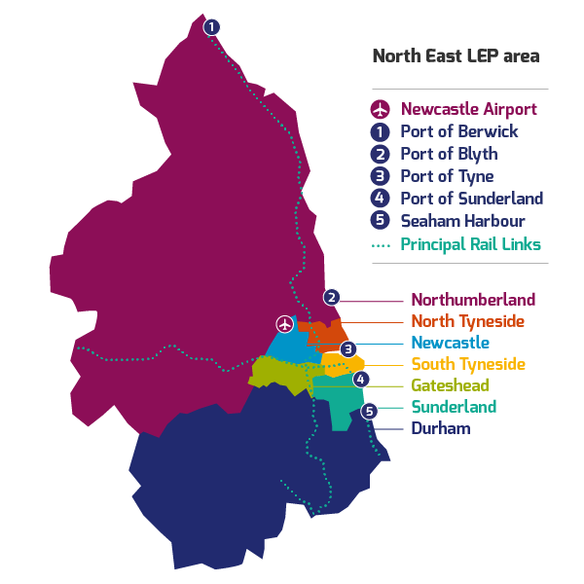
1
What is Labour Market Information?
Define: Labour Market Information(LMI)
This tells you about the current work and job opportunities in your area.
LMI is important for social mobility. It allows young people to be more equipped to understand what is on offer in their region and how to get there by making informed decisions about their future career choices.
Class discussion (2-3 mins)
How do you think Labour Market Information could help you find a job in your area?
It helps decode the world of work by breaking it down into digestible chunks.
LMI highlights the fantastic career opportunities available and what existing opportunities and growth areas there are in your region.
©VotesforSchools The WOW Show 2022
Notes:
Images
1) North East LEP
References
http://www.lmiforall.org.uk/explore_lmi/
https://www.lmiforall.org.uk/explore_lmi/learning-units/what-is-lmi/ - There is a YouTube video explaining LMI if needed on this page.

Slide 5


1
What is Labour Market Information?
LMI can help you understand what jobs are available near to you. It can also show how many jobs there are in different sectors now, and how many there are projected to be in the future.
Define: Sector
An area of work and production that makes money for an area or country.
Individual activity (2-3 mins)
Write down three careers that interest you for the future.
LMI could help you see where job opportunities are and how much certain roles pay. This can help you think about what you want.
LMI is updated regularly, so you can see how job opportunities change and some sectors grow.
©VotesforSchools The WOW Show 2022
Notes:
Images
1) North East LEP
References
http://www.lmiforall.org.uk/explore_lmi/
https://www.lmiforall.org.uk/explore_lmi/learning-units/what-is-lmi/ - There is a YouTube video explaining LMI if needed on this page.

Slide 6







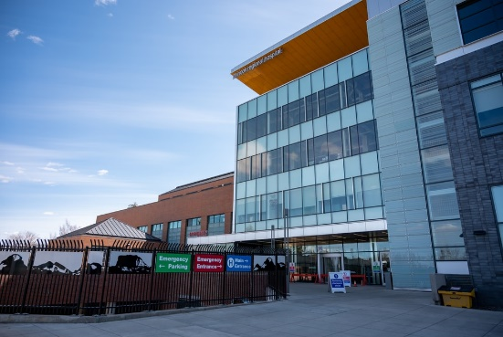
2
The North East Labour Market
Pair discussion (2-3 mins)
Talk to your partner about what opportunities you know of in your local area – click for some picture hints. Then, head to the next slide for more information on the sectors that have roles on offer in the North East.
Challenge:
Do you know what kind of work is involved in each of these sectors?
©VotesforSchools The WOW Show 2022
Notes:
Please Note: The North East Local Enterprise Partnership works with partners to develop a more competitive economy for the North East, Helping to create more and better jobs for everyone.
Images
Unsplash
References
https://www.northeastambition.co.uk/toolkits/labour-market-insights-toolkit
https://www.northeastlep.co.uk/key-sectors/
https://evidencehub.northeastlep.co.uk/report/gva-industry
https://dictionary.cambridge.org/dictionary/english/manufacturing
https://dictionary.cambridge.org/dictionary/english/administration
https://dictionary.cambridge.org/dictionary/english/retail
https://dictionary.cambridge.org/dictionary/english/social-care

Slide 7




2
The North East Labour Market
Transport & Logistics:
Transport of people and movement of goods (things we buy).
Advanced Manufacturing:
This includes making parts for cars, trains, electronics and subsea engineering.
Construction:
Building and work across all parts of our built environment.
Health & Social Care:
Research and development into health and care (looking after people).
©VotesforSchools The WOW Show 2022
Notes:
Please Note: The North East Local Enterprise Partnership works with partners to develop a more competitive economy for the North East, Helping to create more and better jobs for everyone.
Images
Unsplash
References
https://www.northeastambition.co.uk/toolkits/labour-market-insights-toolkit
https://www.northeastlep.co.uk/key-sectors/
https://evidencehub.northeastlep.co.uk/report/gva-industry
https://dictionary.cambridge.org/dictionary/english/manufacturing
https://dictionary.cambridge.org/dictionary/english/administration
https://dictionary.cambridge.org/dictionary/english/retail
https://dictionary.cambridge.org/dictionary/english/social-care

Slide 8




2
The North East Labour Market
Digital:
Work involving Information Technology (IT) and digital data.
Education:
There are over 1,150 schools in the North East and five universities.
Financial & Business Services:
This includes financial and legal services.
Energy:
Research and development in producing energy.
©VotesforSchools The WOW Show 2022
Notes:
Please Note: The North East Local Enterprise Partnership works with partners to develop a more competitive economy for the North East, Helping to create more and better jobs for everyone.
There are four Universities in the North East LEP and one in Tees Valley
There are nine Further Education colleges and two sixth forms
There are over 240 secondaries including SEND, PRU and Alternative Provision
There are over seven hundred primaries
Images
Unsplash
References
https://www.northeastambition.co.uk/toolkits/labour-market-insights-toolkit
https://www.northeastlep.co.uk/key-sectors/
https://evidencehub.northeastlep.co.uk/report/gva-industry
https://dictionary.cambridge.org/dictionary/english/manufacturing
https://dictionary.cambridge.org/dictionary/english/administration
https://dictionary.cambridge.org/dictionary/english/retail
https://dictionary.cambridge.org/dictionary/english/social-care

Slide 9
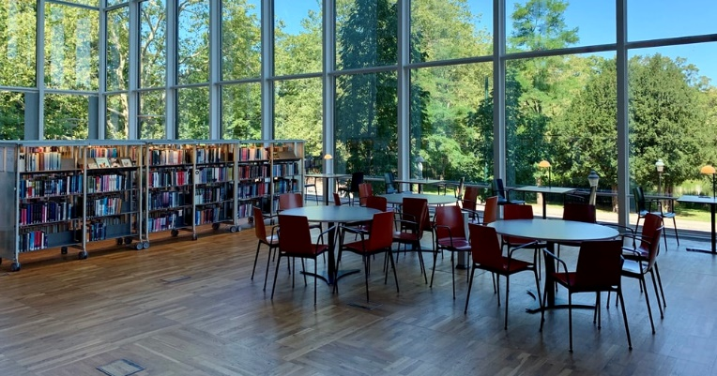




2
The North East Labour Market
Mind the gaps (3-5 mins)
Now you’ve seen the range of active sectors in the North East, it’s time to see some of the numbers behind them. On your own or in a pair, choose the right answer to fill the gap in each statement on the next few slides – you can use the images to help you. Then, click to see if you’re right!
©VotesforSchools The WOW Show 2022
Notes:
Images
Unsplash
References
https://www.northeastlep.co.uk/key-sectors/digital/
https://www.northeastlep.co.uk/key-sectors/advanced-manufacturing/
https://www.northeastlep.co.uk/key-sectors/energy/

Slide 10

2
The North East Labour Market
On your own or in a pair, choose the right answer to fill the gap!
A
26%
B
52%
_______% of all electric cars made in the UK are produced in the North East.
C
78%
©VotesforSchools The WOW Show 2022
Notes:
Images
Unsplash
References
https://www.northeastlep.co.uk/key-sectors/digital/
https://www.northeastlep.co.uk/key-sectors/advanced-manufacturing/
https://www.northeastlep.co.uk/key-sectors/energy/

Slide 11

2
The North East Labour Market
On your own or in a pair, choose the right answer to fill the gap!
A
10,000
B
29,000
C
There are _________ people employed in the North East in IT and digital industries
45,000
©VotesforSchools The WOW Show 2022
Notes:
Images
Unsplash
References
https://www.northeastlep.co.uk/key-sectors/digital/
https://www.northeastlep.co.uk/key-sectors/advanced-manufacturing/
https://www.northeastlep.co.uk/key-sectors/energy/

Slide 12
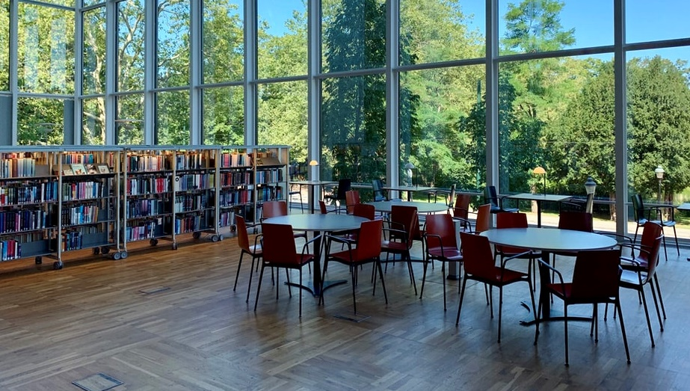
2
The North East Labour Market
On your own or in a pair, choose the right answer to fill the gap!
A
81,000
B
110,000
___________ students study in the region’s 5 universities.
C
210,000
©VotesforSchools The WOW Show 2022
Notes:
Images
Unsplash
References
https://www.northeastlep.co.uk/key-sectors/digital/
https://www.northeastlep.co.uk/key-sectors/advanced-manufacturing/
https://www.northeastlep.co.uk/key-sectors/energy/

Slide 13

2
The North East Labour Market
On your own or in a pair, choose the right answer to fill the gap!
A
7,000
B
700
C
There are currently __________ people employed in life sciences in the North East.
70
©VotesforSchools The WOW Show 2022
Notes:
Images
Unsplash
References
https://www.northeastlep.co.uk/key-sectors/digital/
https://www.northeastlep.co.uk/key-sectors/advanced-manufacturing/
https://www.northeastlep.co.uk/key-sectors/energy/

Slide 14

2
The North East Labour Market
On your own or in a pair, choose the right answer to fill the gap!
A
Electric cars
B
Offshore wind
The North East is a global leader in __________.
C
Eco-farming
©VotesforSchools The WOW Show 2022
Notes:
Images
Unsplash
References
https://www.northeastlep.co.uk/key-sectors/digital/
https://www.northeastlep.co.uk/key-sectors/advanced-manufacturing/
https://www.northeastlep.co.uk/key-sectors/energy/

Slide 15


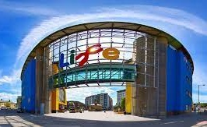

3
Your North East opportunities in Health and Life Sciences
Whether you are interested in a career in the NHS or in the development and manufacture of medicines, the North East has thousands of opportunities through many different routes.
0:00-2:18
The Centre for Life carries out ground-breaking medical research.
Class activity (4-6 mins)
Click the NHS Apprenticeships image to watch the video and discuss what you are thinking about doing after your GCSEs. Are you thinking about further education or a career through an apprenticeship. Why?
NHS Jobs is an online recruitment service for the NHS and other health related organisations. There are around 20,000 adverts every month, therefore, if you are looking for a career in the NHS or in a health related career, this site should be your first port of call.
©VotesforSchools The WOW Show 2022
Notes:
YouTube Video Link: https://www.youtube.com/watch?v=I5KyXKre9So
SafeShare Video Link: https://safeshare.tv/x/I5KyXKre9So
Images
NELEP
References:
https://www.jobs.nhs.uk/advice/intro.html
https://www.life.org.uk/about
https://jobs.life.org.uk/

Slide 16








4
Are you aware of the skills needed for a career?
Pair activity (3-5 mins)
As well as qualifications and specialist skills, the other types of skills employers look for are known as “soft skills”. Can you come up with a list of the skills you think are needed to be employable? Click if you need a little help!
Leadership
Teamwork
Problem-solving
Listening
Aiming High
Speaking
Creativity
Staying Positive
©VotesforSchools The WOW Show 2022
Notes:
Teacher’s Note: Many North East schools use https://www.skillsbuilder.org/ to support this area of the curriculum.
Images
Unsplash

Slide 17


5
The art of being imaginative & flexible
Some careers need people who have a great imagination and can be flexible.
Class activity (2-3 mins)
In which careers do you think a good imagination would be useful and why? Present your ideas as you see fit!
Sometimes you need to be imaginative to solve a problem. A problem could be anything from a concern about a product design, to issues you are having in a professional relationship. A good example would be a chef coming up with a menu for delivery boxes to reach more people!
There are many ways of working, but where and when you work has become much more flexible in recent years.
©VotesforSchools The WOW Show 2022
Notes:
Images
Pixabay
Unsplash
References
1)

Slide 18

6
How well do you communicate?
Class discussion (2-3 mins)
Why is listening so important for good communication? How are your listening skills? In which careers do you think you would need good communication?
The main essential skill that employers in the North East (and in the rest of the country) are looking for is good communication.
©VotesforSchools The WOW Show 2022
Notes:
Images
1) Icons8

Slide 19






6
How well do you communicate?
Individual reflection (1-2 mins)
How are your communication skills? Do you always make sure to do the things below?
Pair activity (1-2 mins)
Come up with a list of things you can do to improve your communication skills!
Value and respect the speaker?
Look at the person speaking?
Ask thoughtful questions?
Wait your turn to speak?
Think about what is being said?
Listen to all of the information?
©VotesforSchools The WOW Show 2022
Notes:
Images
Unsplash

Slide 20

7
Planning your future: GCSEs
Before kickstarting your career, some transitions need to take place! This starts with your GCSEs…
Define: Transition
The change from one part of your life to a new phase.
0:00-2:21
Pair discussion (3-5 mins)
Click the image to watch a video about choosing your GCSEs. Discuss with your partner: what can you do to make sure you feel confident about your choices?
During the move from KS3 to KS4, you may feel ready to think about your future when you leave school.
It is important to choose the right GCSEs to make sure you are qualified to do your dream job!
But, if you are not sure what you want to do, try to choose a good balance to keep your options open.
Don’t forget, most of us work for about 40 years, so it’s important you choose things that you enjoy!
©VotesforSchools The WOW Show 2022
https://safeshare.tv/x/d_ssJV_XfjQ
Notes:
YouTube Video Link: https://www.youtube.com/watch?v=d_ssJV_XfjQ&feature=emb_logo
SafeShare Video Link: https://safeshare.tv/x/d_ssJV_XfjQ
Images
Via video
References
https://www.prospects.ac.uk/careers-advice/getting-a-job/skills-shortages-and-covid-19
https://dictionary.cambridge.org/dictionary/english/transition
https://www.youtube.com/watch?v=d_ssJV_XfjQ&feature=emb_logo

Slide 21



7
Planning your future: GCSEs
As you saw on the last slide, it’s important to think about the following things when it comes to choosing your GCSEs:
What you want to do in the future
Which subjects you are good at
Which subjects or topics you enjoy
Pair discussion (2 mins)
Have you thought about which GCSEs you would like to do? How will they help you achieve your future goals in the North East?
©VotesforSchools The WOW Show 2022
Notes:
YouTube Video Link: https://www.youtube.com/watch?v=_BisOOPk7xw
SafeShare Video Link: https://safeshare.tv/x/_BisOOPk7xw
Images
Unsplash
References
https://www.youtube.com/channel/UCPwftEor7g8nOg6cu-R0KXw (University of Exeter)
https://nationalcareersservice.direct.gov.uk/job-profiles/home

Slide 22



7
Planning your future: GCSEs
0:00-1:48
Class activity (2 mins)
Click the image to watch the clip all about what GCSEs are and why they are important.
Although age 13 or 14 might feel quite early to be thinking about a career, choices you make now can really help in the future!
Challenge:
Want to know more? Why not talk to a teacher, school careers adviser, or visit the National Careers Service website?
©VotesforSchools The WOW Show 2022
Notes:
YouTube Video Link: https://www.youtube.com/watch?v=_BisOOPk7xw
SafeShare Video Link: https://safeshare.tv/x/_BisOOPk7xw
Images
Unsplash
References
https://www.youtube.com/channel/UCPwftEor7g8nOg6cu-R0KXw (University of Exeter)
https://nationalcareersservice.direct.gov.uk/job-profiles/home
https://nationalcareers.service.gov.uk/contact-us

Slide 23



8
Rights & responsibilities in your chosen career
Both employers and their employees have rights and responsibilities in the workplace. It is important that you know about both.
Define: Employer
The person who gives you the job.
Define: Employee
A person who works for someone else.
Individual activity (1-2 mins)
Write down the top three responsibilities you think you, as an employee, would have at work. Then, share your ideas as a class. Click for some picture prompts.
©VotesforSchools The WOW Show 2022
Notes:
Teacher notes:
Wearing the correct/appropriate clothing
Timekeeping
Good skills to fit the job
Digital skills/literacy
Images
Unsplash
References
https://dictionary.cambridge.org/dictionary/english/employer
https://dictionary.cambridge.org/dictionary/english/employee

Slide 24



8
Rights & responsibilities in your chosen career
Individual activity (1-2 mins)
Now write down the top three responsibilities you think an employer would have at work. Compare your answers as a class. Click for some ideas.
Challenge:
How many of these apply to both employees and employers?
©VotesforSchools The WOW Show 2022
Notes:
Teacher notes:
Health and safety
A positive/healthy environment
Clear holidays and working hours
Fair/clear practices and policies
Images
Unsplash
References
https://dictionary.cambridge.org/dictionary/english/employer
https://dictionary.cambridge.org/dictionary/english/employee

Slide 25



9
Take the initiative in your life
The internet has a whole host of information sources. For instance, The National Careers Service, Start and icould all have great support and advice. Click on the logos to visit their sites.
The National Careers Service provides careers information, advice and guidance. They can help you to make decisions on learning, training and work at all stages in your career.
Start will help you to find out which subjects and qualifications will help to prepare you for your future? Also, which pathway is right for you?
icould is a great place to get tips on GCSE options, apprenticeships, university, finding work (and much more!).
©VotesforSchools The WOW Show 2022
Notes:
Images & References
https://icould.com/
https://careers.startprofile.com/page/home-page
https://nationalcareers.service.gov.uk/

Slide 26
Thank you!
©VotesforSchools The WOW Show 2022

