Slide 1
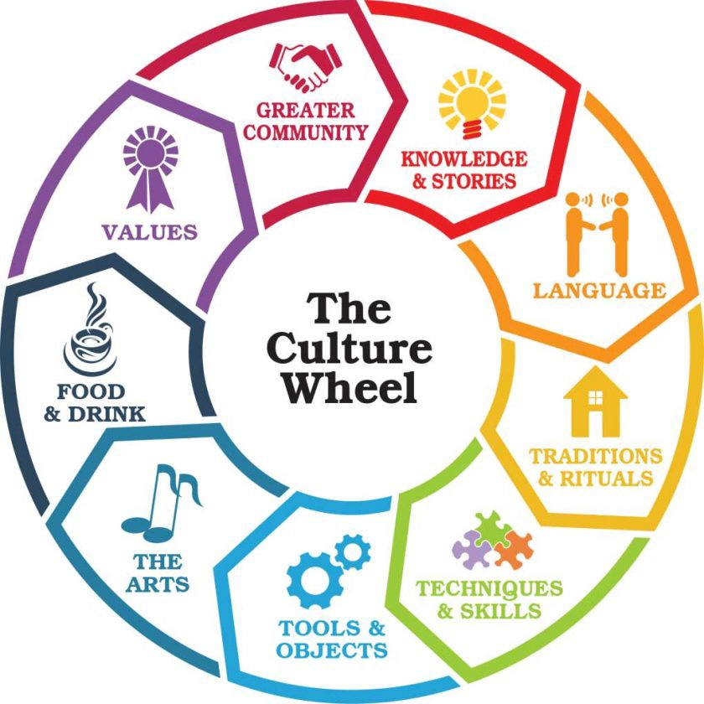
Year 7 cycle 3 – Culture and Identity
Culture | The ideas, customs, and social behaviour of a particular people or society
Fiction | Literature in the form of prose that describes imaginary events and people
Non-Fiction | Prose writing that is informative or factual
Structure | How a text is organised
Language | The words and techniques chosen by a writer
Characterisation | The creation or construction of a fictional character
Plot Structure | The organisation of the storyline in fiction
Exposition | The opening of a story
Rising Action | The building of the events in the storyline
Climax | The purpose/key action in the storyline
Falling Action | The consequences of the climax
Resolution | The ending of the plot
Perspective | The point of view of the writer
Inference | A conclusion based on reasoning and evidence in a text
Tone | A writers attitude or mood
Theme | The ideas a text is about
Terminology Focus
Imperative Verbs | Verbs to instruct
Non-Standard English | Forms that differ from Standard English e.g. regional dialects
Repetition | Repeating of words/phrases
Lists | Placing items one after another in a sentence
Enjambment | The continuation of a sentence beyond the line
Juxtaposition | Placing of two contrasting ideas near each other
Simile | Using like or as to make a comparison
Alliteration | Words near each other start with the same sound
Metaphor | Making a comparison by saying something is something else
Onomatopoeia | Words which make the sounds they represent
Personification | A type of metaphor giving human qualities to a none human thing
Adjective | Describes a noun
Adverb | Describes a verb
Rhyming Couplet | Two lines of poetry which rhyme
Literacy Focus
Capital Letter | Used at the start of sentences, for proper nouns and abbreviations
Full Stop | Marks the end of a sentence
Apostrophe | Marks omission and possession
Comma | Used to separate clauses and items in a list
Semi Colon | Marks a pause between clauses or longer items in a list
Colon | Introduces a list or explanation
Brackets | To add additional information to the sentence
Dashes | To add additional information to the sentence
Sentence | A complete unit of meaning containing a main verb
Simple | One clause; one main verb
Compound | Two clauses of equal value joined by and/or/so/but
Complex | At least two clauses, a main and subordinate

