Slide 1
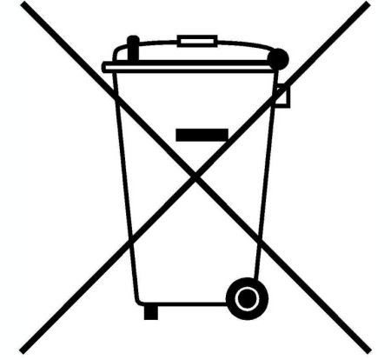
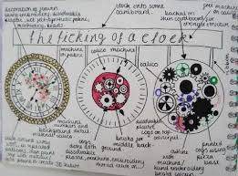
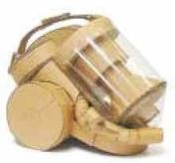
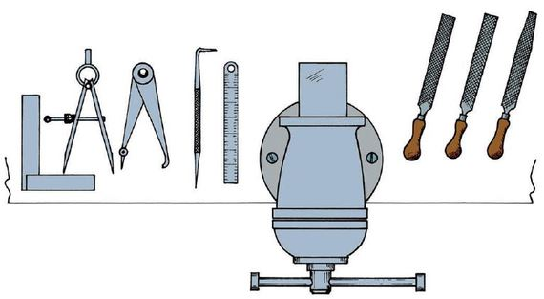
Cycle | Content | Skills
1 | Brief/Task Analysis/Tools & Equipment Research and Design Specification Design Idea Development Risk Assessment/Modelling Ideas Risk Assessment/Practical Sawing | Understanding tools & equipment Identifying user needs Idea communication and development Understanding risks & hazards/Modelling solutions Understanding risks associated with a hack saw
KS3 Knowledge Organiser: Y9 CAD & Engineering
Key knowledge
Target audiences: When designing you need to think about the customer, client and end user. Sometimes they will be the same, but often they are different people who will have different needs and wants from the product. For example a dog bowl. The client might be a pet shop, the customer would be the pet owner and the end user would be the dog. Whose needs are most important will depend on the product being made. | Environmental impacts of products: When designing a product it is important to think about the environmental impacts all the way through the product’s life. This might be the energy used in the extraction of raw materials or during manufacturing. It could be the transport of materials or finished products for sale. It will also include any consumable items when the product is being used, like batteries, as well as how the product will be disposed of at the end of its life.
Curriculum Links
Literacy: Specification writing, PEE chains, justification and analysis skills, use of acronyms. Numeracy: Costing, dimensions, scale, proportion, graphical representation. Careers: Problem solving, software skills, communication skills. Cultural Capital: Specification writing, design skills, communication.
Key words
Specification – A list of points about a product. Aesthetics – What a product looks like. Cost – How much a product costs. Customer – Who will buy/use the product. Environment – Where the product will be used. Safety – Are there any safety issues with the product? Size – The measurements/size of the product. Function – What the product will do. Materials – What the product is made from. Manufacture – How the product is made. Annotation – When you explain ideas. Shade/Tone – Adding colour to sketches. Hazard – Something that can cause an accident. Hack Saw – A tool used to cut materials like metal.
Recognising & Modelling Ideas
Key skills
Product Specification: The ‘specification’ is probably the most important part of the design process because it makes sure your product is going to do what it needs to do. It is a list of points which outline the design criteria for the product, with each point referring to research work you have done. You can organize your points so you don’t miss anything using ACCESS FM and expand your writing using PEE chains.
Design idea development: First develop a range of initial ideas and compare them with your specification. You can then see any areas which are less good and look at how to improve them to produce a final idea. Annotation helps explain designs fully and using 3D sketching and ACCESS FM for your annotation will make your ideas clear. Improving and developing designs based on feedback is called iterative design.
Card modelling: Card modelling is another way to test a design before proper production begins. One major advantage of using card is if you make a mistake, each part can be remodeled at very little cost. When assembled correctly they can be really strong and last for many years. Creating a card model is easy and can quickly show what a product will look like so it can be evaluated.
Key skills
Risk Assessment: This term is used to describe the overall process or method where you: Identify hazards and risk factors that have the potential to cause hazard. After hazard identification, you then consider appropriate ways to eliminate the hazard, or control the risk when the hazard cannot be eliminated, this is called risk control.
Manufacturing: Using key manufacturing skills safely and practicing to develop your skill and accuracy so that the products you make are high quality. In Engineering this includes hand tools, heat treatment, laser cutting, drilling and welding.

Slide 2
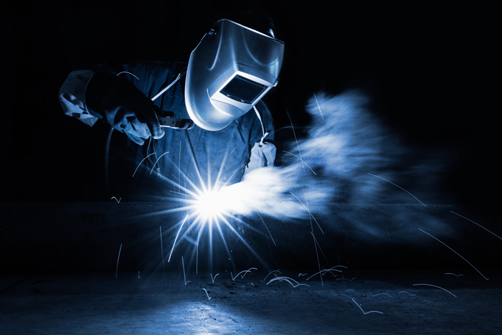
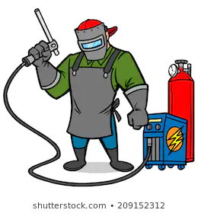
Cycle | Content | Skills
2 | Risk Assessment/Practical Drilling Mechanical Systems, Movement and Force Risk Assessment/Practical Filing Risk Assessment/Practical Polishing CAD Drawing/2D Designer | Understanding risks associated with a drill Understanding mechanical systems Understanding risks associated with a file Understanding risks associated with polishing metal Understanding orthographic drawing
KS3 Knowledge Organiser: Y9 CAD & Engineering
Key skills
Risk Assessment: This term is used to describe the overall process or method where you: Identify hazards and risk factors that have the potential to cause hazard. After hazard identification, you then consider appropriate ways to eliminate the hazard, or control the risk when the hazard cannot be eliminated, this is called risk control.
Manufacturing: Using key manufacturing skills safely and practicing to develop your skill and accuracy so that the products you make are high quality. In Engineering this includes hand tools, heat treatment, laser cutting, drilling and welding.
Key words
Manufacture – To make a product. Risk Assessment – A document used to assess dangers in a workshop. Hazard – Something that can cause an accident. Hack Saw – A tool used to cut materials like metal. Drill – A tool used to make various size holes in materials. File – A tool used to smooth the edges of various materials. Welding – A process used to join metals together. CAD – Computer Aided Design. Using a computer to help you design. Vectorise – A technique used to convert an image so that it is suitable for a CAM process. CAM – Computer Aided Manufacture. Using a machine to help you make a product.
Manufacturing Safely
Key knowledge
2D Command Tools: | Quality Control and Quality Assurance: Quality Control is a system of maintaining standards in manufactured products by testing a sample of the output against the specification. Quality Assurance is a way of preventing mistakes and defects in manufactured products and avoiding problems when delivering products or services to customers. Quality Assurance makes sure quality is created during the designing phase. Whereas in Quality Control, quality is created at the production stages. Quality Assurance is a preventive action, but Quality Control is a corrective measure.
Key skills
Technical Drawings: Technical drawings have to conform to BS 8888 which is a set of rules that the drawing must follow. Drawing Standards exist so that everyone using the drawing can understand them clearly and shows the information in the same way. Often the parts being shown on the drawings are too big to draw full size, so they are drawn to scale. This means drawing them in a smaller size than they really are. The scale being used is shown on the drawing in the title block. | Orthographic drawing layout: | 2D drawing technique which shows the top (plan), front and side (end) view of a product. Used to show technical information such as dimensions clearly.
Curriculum Links
Literacy: Risk assessment, processing instructions, use of technical documentation. Numeracy: Planning, dimensions, marking out. Careers: Problem solving, hand skills, communication skills. Cultural Capital: H&S/Risk awareness, manufacturing skills, communication.

Slide 3
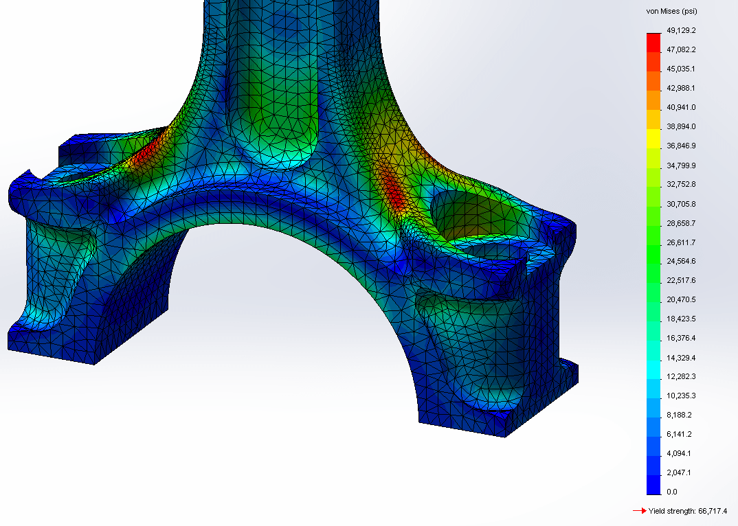
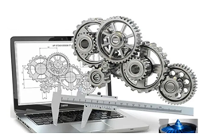
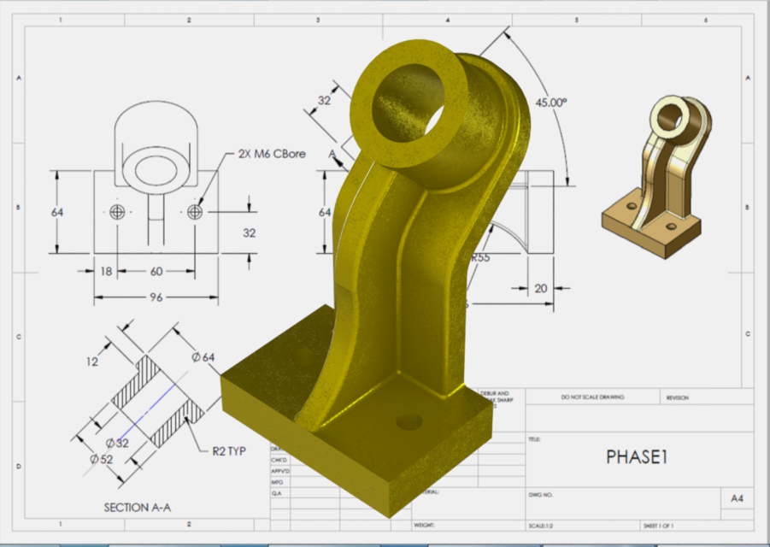
Cycle | Content | Skills
3 | CAD Tools/CAD Modelling Orthographic Drawing Laser Cutting/Product Evaluation Design Improvement and Development/User Surveys End of Year Test | Understanding CAD tools Testing and correcting issues Analysing and evaluating to improve. Responsible design decisions/User surveys Retention of key knowledge
KS3 Knowledge Organiser: Y9 CAD & Engineering
Key skills
Testing and Evaluating: By comparing your finished product with the specification and also by asking for 3rd party feedback, you can identify strengths and weaknesses with the design and manufacture of the item. You can use this information to suggest ways it could be improved or developed in the future.
CAD: 3D computer modelling means using a computer programme to create a virtual representation of a real object. This drawing can then be used to programme a piece of machinery to cut out a real physical product. The model can also be rendered to make it look real by choosing a colour and a material. A number of 3D model parts can be put together to make an assembly. Once the complete 3D model is created, it can be used to create a technical drawing. These drawings are used when the product is made to make sure it is the right shape and size.
Laser cutting process: Draw your image on 2D design, or vectorise an existing image. Then change cut lines to black and engrave lines to red. Export the image as a DXF file to the laser cutter. Place the material into the laser and follow the settings and safety rules in the handbook to cut it out correctly. |  | Heat treatment: Heat Treatment in Design and Technology involves the use of heat to raise the temperature of a material (usually metal) to a point where changes in its crystalline structure occur and alter its working characteristics. Often this means it is easier to work with and shape. The source of heat could be a Blow Torch but in industry, more consistency and accuracy is achieved by the use of temperature controlled ovens and kilns.
Curriculum Links
Literacy: Risk assessment, processing instructions, use of technical documentation. Evaluation. Numeracy: Checking, estimating, dimensions, marking out. Careers: Problem solving, hand skills, communication skills. Cultural Capital: Manufacturing skills, communication, production.
Key words
Testing – To test an item after it has been made. Evaluating – To give positives, negatives and a summary about a product. 3rd Party Feedback – To ask another person to give an opinion about a product. CAD – Computer Aided Design. Using a computer to help you design. CAM – Computer Aided Manufacture. Using a machine to help you make a product. Forge – A process used to heat metal so that it can be shaped. Strength – The maximum force a product can hold without breaking. Ductility – To be deformed without losing toughness. Elasticity – The ability of a material to return to its original shape. Characteristic – A feature or quality.
Material Properties
Key knowledge
Material properties: Strength – The ability of a material to stand up to forces being applied without it bending, breaking, shattering or deforming in any way. Elasticity – The ability of a material to absorb force and flex in different directions, returning to its original position. Ductility - The ability of a material to change shape (deform) usually by stretching along its length. Plasticity - The ability of a material to change in shape permanently. Tensile Strength - The ability of a material to stretch without breaking or snapping. | Advantages and Disadvantages of welding:
 | Advantages: Strong Lightweight joint More effective than riveting Look neat and tidy Quick to produce Rigid No noise | Disadvantages: Brittle Don’t cope well with fatigue Skilled labour needed to weld Electricity is required for welding. Inspection of welding work is more difficult and costly than riveting. Easy to get defects in the joint which are difficult to detect. Risks are higher from welding flash
Properties of steel: Steel is an alloy of iron and carbon and, sometimes, other elements such as chromium. Because of its high tensile strength and low cost, this material is best used in buildings, infrastructure, tools, ships, trains, cars, machines, electrical appliances, and weapons.

