Slide 1
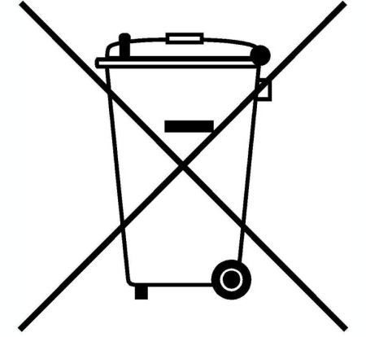
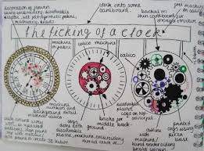
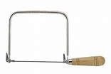
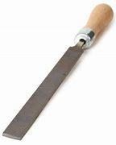
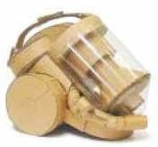
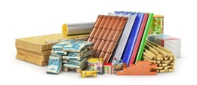
Cycle | Content | Skills
1 | Brief/Task Analysis Research and Design Specification Design Idea Development Modelling Ideas/Templates Tools and Equipment Risk Assessment/Practical Sawing, Filing, Drilling, Finishing | Identifying user needs Idea communication and development Understanding modelling solutions Understanding tools & equipment Understanding risks & hazards associated with a coping saw, file, drill
KS3 Knowledge Organiser: Y8 Electronics
Key knowledge
Target audiences: When designing you need to think about the customer, client and end user. Sometimes they will be the same, but often they are different people who will have different needs and wants from the product. For example a dog bowl. The client might be a pet shop, the customer would be the pet owner and the end user would be the dog. Whose needs are most important will depend on the product being made. | Environmental impacts of products: When designing a product it is important to think about the environmental impacts all the way through the product’s life. This might be the energy used in the extraction of raw materials or during manufacturing. It could be the transport of materials or finished products for sale. It will also include any consumable items when the product is being used, like batteries, as well as how the product will be disposed of at the end of its life.
Curriculum Links
Literacy:​ Specification writing, PEE chains, Justification and analysis skills, use of acronyms.​ Numeracy:​ Costing, dimensions, scale, proportion, graphical representation.​ Careers:​ Problem solving, communication Skills. Cultural Capital:​ Specification writing, design skills, communication.
Key words
Specification – A list of points about a product. Aesthetics – What a product looks like. Cost – How much a product costs. Customer – Who will buy/use the product. Environment – Where the product will be used. Safety – Are there any safety issues with the product? Size – The measurements/size of the product. Function – What the product will do. Materials – What the product is made from. Manufacture – How the product is made. Annotation – When you explain ideas. Shade/Tone – Adding colour to sketches. Hazard – Something that can cause an accident. Coping Saw – A tool used to cut materials like wood.
Recognising & Modelling Ideas
Key skills
Product Specification: The ‘specification’ is probably the most important part of the design process because it makes sure your product is going to do what it needs to do. It is a list of points which outline the design criteria for the product, with each point referring to research work you have done. You can organize your points so you don’t miss anything using ACCESS FM and expand your writing using PEE chains.
Design idea development: First develop a range of initial ideas and compare them with your specification. You can then see any areas which are less good and look at how to improve them to produce a final idea. Annotation helps explain designs fully and using 3D sketching and ACCESS FM for your annotation will make your ideas clear. Improving and developing designs based on feedback is called iterative design.
Card modelling: Card modelling is another way to test a design before proper production begins. One major advantage of using card is if you make a mistake, each part can be remodeled at very little cost. When assembled correctly they can be really strong and last for many years. Creating a card model is easy and can quickly show what a product will look like so it can be evaluated.
Key skills
Risk Assessment: This term is used to describe the overall process or method where you: Identify hazards and risk factors that have the potential to cause hazard. After hazard identification, you then consider appropriate ways to eliminate the hazard, or control the risk when the hazard cannot be eliminated, this is called risk control.
Manufacturing: Using key manufacturing skills safely to develop your skill and accuracy so that the products you make are high quality. In Electronic Product Design this includes hand tools, vacuum forming, laser cutting, belt sanding and drilling.
Production Plan: When manufacturing a product it is important that you complete each stage of the process carefully and accurately. Writing a production plan can help you to organise each step logically.

Slide 2
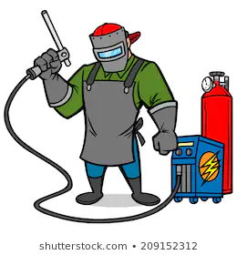
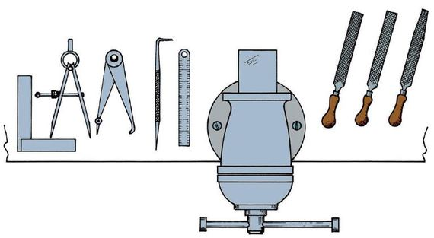
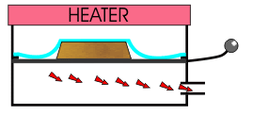
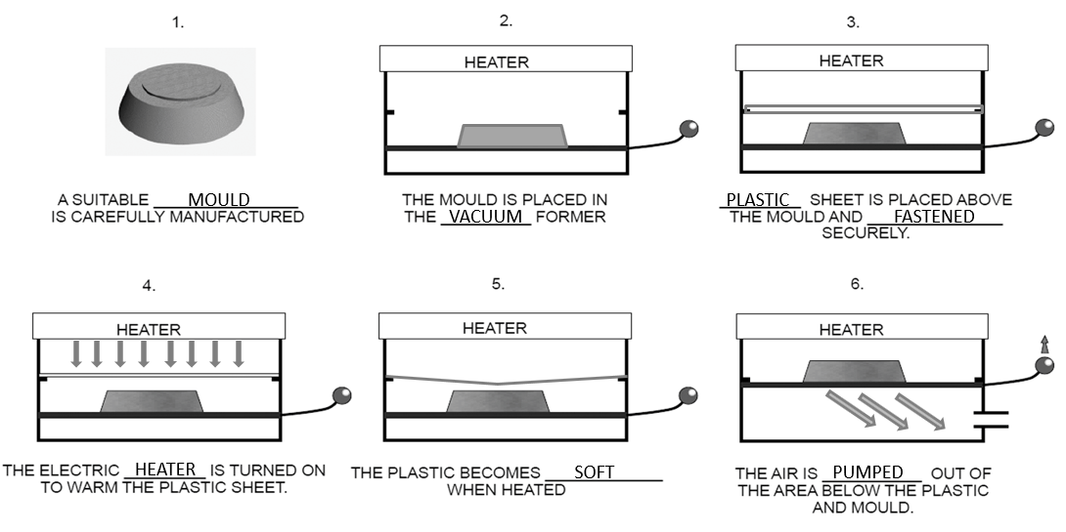
Cycle | Content | Skills
2 | Clock Practical Materials and their Properties Brief/Task Analysis Vacuum Forming Design Idea Development Practical – Body of Jitterbug CAD Drawing/2D Designer Orthographic Drawing | Understanding materials and their properties Identifying user needs Understanding how the Vacuum Former works Understanding Health & Safety Idea communication and development Understanding CAD Drawings
KS3 Knowledge Organiser: Y8 Electronics
Key skills
Technical Drawings: Technical drawings have to conform to BS 8888 which is a set of rules that the drawing must follow. Drawing Standards exist so that everyone using the drawing can understand them clearly and shows the information in the same way. Often the parts being shown on the drawings are too big to draw full size, so they are drawn to scale. This means drawing them in a smaller size than they really are. The scale being used is shown on the drawing in the title block. | Orthographic drawing layout: | 2D drawing technique which shows the top (plan), front and side (end) view of a product. Used to show technical information such as dimensions clearly.
Key words
Manufacture – To make a product. Risk Assessment – A document used to assess dangers in a workshop. Hazard – Something that can cause an accident. Coping Saw – A tool used to cut materials like wood. Drill – A tool used to make various size holes in materials. File – A tool used to smooth the edges of various materials. Vacuum Former – A tool process used to shape plastic. CAD – Computer Aided Design. Using a computer to help you design. Vectorise – A technique used to convert an image so that it is suitable for a CAM process. CAM – Computer Aided Manufacture. Using a machine to help you make a product.
Manufacturing Safely
Key knowledge
Materials can be split into different categories. The materials and manufacturing methods that are used to make the jitterbug are: Materials: HIPS (Thermoplastic) – used for the body of the jitterbug. Electronic components – used for the circuit. Manufacturing Methods: Vacuum forming – used to manufacture the body. Soldering – used to manufacture the circuit.
Vacuum Forming: This is the production method that is used to manufacture the casing for the jitter bug. It involves using a suitable mould (wood) and heating a suitable material (plastic) on a vacuum forming machine. The plastic is heated until soft and then shaped around the mould.
Curriculum Links
Literacy: Risk assessment, processing instructions, use of technical documentation. Numeracy: Planning, dimensions, marking out. Careers: Problem solving, hand skills, communication skills Cultural Capital: H&S/Risk awareness, manufacturing skills, communication.
Key knowledge

Slide 3
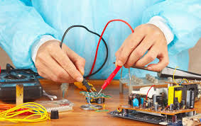
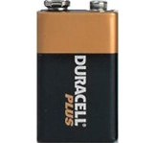
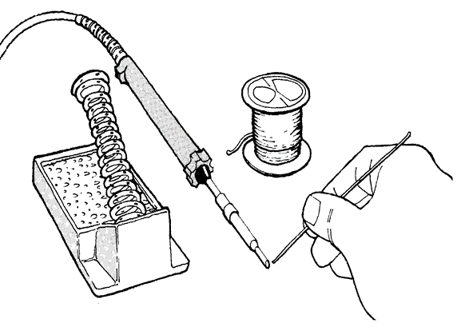
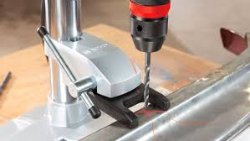
Cycle | Content | Skills
3 | Inputs/Processes/Outputs Components and their Uses Soldering Safety Circuit Manufacture Energy Sources/Renewable Energy Testing and Evaluation Design Improvement and Development/User Surveys End of Year Test | Understanding Electronic Components/Soldering Understanding Energy Sources and Renewable Energy Testing and correcting issues Analysing and evaluating to improve. Responsible design decisions/User surveys Retention of key knowledge
KS3 Knowledge Organiser: Y8 Electronics
Key skills
Testing and Evaluating: By comparing your finished product with the specification and also by asking for 3rd party feedback, you can identify strengths and weaknesses with the design and manufacture of the item. You can use this information to suggest ways it could be improved or developed in the future.
User Survey: User surveys are used to find out whether your product is successful. It can help you find weaknesses and fix them before you mass produce your product. A user survey could include closed and open ended questions which allow you to analyse the answers and make improvements.
Systems: All systems have an INPUT, PROCESS and an OUTPUT. The INPUT is the component that makes the circuit work. E.g. A switch is used to turn a circuit on, this is an input. The PROCESS is the part that reacts to the input and the OUTPUT is a component that can change electrical energy into light or sound etc. Testing each system separately often makes it easier to fault find circuits.
Energy Sources: Energy is present in all materials. These materials can be burnt to release the energy as heat. The heat is used to boil water to create steam. This steam then turns a turbine, this turbine powers a generator. A generator can change kinetic energy into electrical energy.
Soldering: This is the method that is used to manufacture the circuit for your jitterbug. It involves using a soldering iron and electronic components to manufacture a circuit. The soldering iron is heated and solder is applied to components to join them.
Curriculum Links
Literacy: Risk assessment, processing instructions, use of technical documentation. Evaluation. Numeracy: Checking, estimating, dimensions, marking out. Careers: Problem solving, hand skills, communication skills. Cultural Capital: Manufacturing skills, communication, production.
Key words
Soldering Iron – A tool used to join electronic components to a circuit board. Solder – A material used to connect components together. Components (LED, resistor, battery, LDR, lamp) Renewable Energy – Energy that is produced and will not run out. Testing – To test an item after it has been made. Evaluating – To give positives, negatives and a summary about a product. 3rd Party Feedback – To ask another person to give an opinion about a product. CAD – Computer Aided Design. Using a computer to help you design. CAM – Computer Aided Manufacture. Using a machine to help you make a product.
Circuits and Components
Key knowledge

