Slide 1
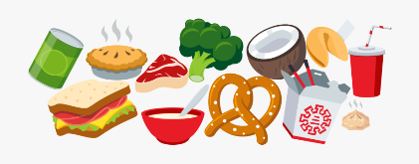
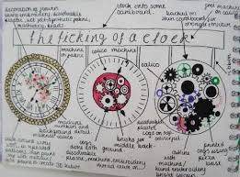
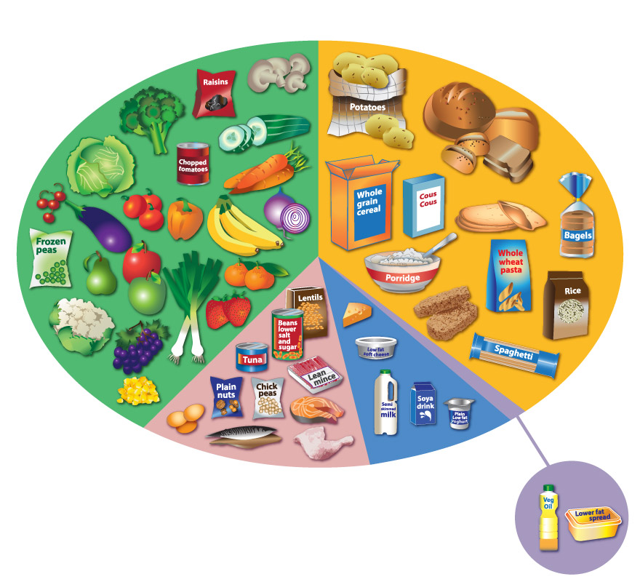
Cycle | Content | Skills
1 | Food safety and hygiene Research and design specification Pizza practical Design idea development Pasta practical Function of ingredients | Food safety and hygiene Identifying user needs Using an oven safely Idea communication and development Using a hob safely Pathogens and food preparation
KS3 Knowledge Organiser: Y7 Food Technology
Key knowledge
Microbes are extremely tiny and are all around us. There are many different types, and some are Good and some are Bad for us.
Good Microbes | Live in yoghurts and probiotic foods | Live in our intestines. | Help us fight infections | Help us digest our food properly.
Bad Microbes | Causes food poisoning. | Grow on dirty surfaces. | Found on raw meat. | Make us ill -cause infections
Key words
Specification – A list of points about a product. Aesthetics – What a product looks like. Cost – How much a product costs. Customer – Who will buy/use the product. Environment – Where the product will be used. Safety – Are there any safety issues with the product? Size – The measurements/size of the product. Function – What the product will do. Materials – What the product is made from. Manufacture – How the product is made. Texture – What the product feels like. Flavour – What the product tastes like. Food Poisoning – The contamination of food that results in sickness. Hygiene – maintaining health and preventing disease through cleanliness.
Food Groups and Hygiene
Function of ingredients
Oats​ | Adds texture or crunchiness, bulks out the mixture, good source of carbohydrates and fibre, help to give a feeling of fullness, promote growth of good bacteria in gut.​
Butter​ | Provides flavour, Keep products moist and extend shelf-life​ Add colour to foods​ and binds mixture together​. Hold air when creamed with sugar​ and provide energy, Vitamins A and D.​
Self raising Flour​ | Provides fibre (especially if wholemeal), makes mixtures rise​. Thickens sauces, forms the bulk of bread, pastry and cake mixes​. If wholemeal, provides colour and texture, gluten in flour produces a stretchy dough, provides carbohydrate, vitamin B, calcium and iron.​
Brown sugar​ | Provides sweetness, provides colour and texture. Caramelises to produce a brown colour​. Retains moisture, Helps to trap air in cake mixtures, Provides carbohydrate.​
Chocolate /fruit​ | Provides sweetness, flavour, provides colour and texture.​ ​
Honey​ | A natural sweetener, honey extends a product’s shelf life by keeping it moister longer, honey inhibits mould growth in baked products. Honey helps to bind the ingredients.​
Curriculum Links
Literacy: specification writing, design communication, key words. Numeracy: Portion control, weighing, measuring, budgeting, Careers/Cultural Capital: Looking at local and cultural foods, hospitality and catering skills. BBC Bitesize links Hygiene in pizza! https://www.bbc.co.uk/bitesize/clips/zxfqxnb Pre cooked rice https://www.bbc.co.uk/bitesize/clips/zh8fb9q Low Fat Mayonnaise https://www.bbc.co.uk/bitesize/clips/zdy76sg
Key skills
Product Specification: The ‘specification’ is probably the most important part of the design process because it makes sure your product is going to do what it needs to do. It is a list of points which outline the design criteria for the product, with each point referring to research work you have done. You can organize your points so you don’t miss anything using ACCESS FM and expand your writing using PEE chains.
Design idea development: First develop a range of initial ideas and compare them with your specification. You can then see any areas which are less good and look at how to improve them to produce a final idea. Annotation helps explain designs fully and using 3D sketching and ACCESS FM for your annotation will make your ideas clear. Improving and developing designs based on feedback is called iterative design.
Healthy diets: This is an eat well plate. The Eatwell Plate is a pictorial summary of the main food groups and their recommended proportions for a healthy diet. It is the method for illustrating dietary advice by the Department of Health. Use the eat well plate to help balance your diet.
Practical Pizza is a dough base that uses yeast similar to bread.

Slide 2
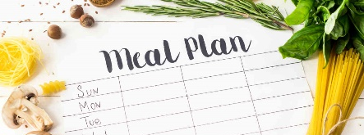
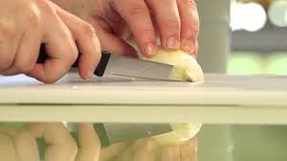
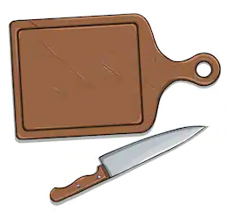
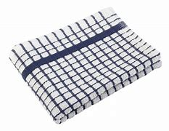
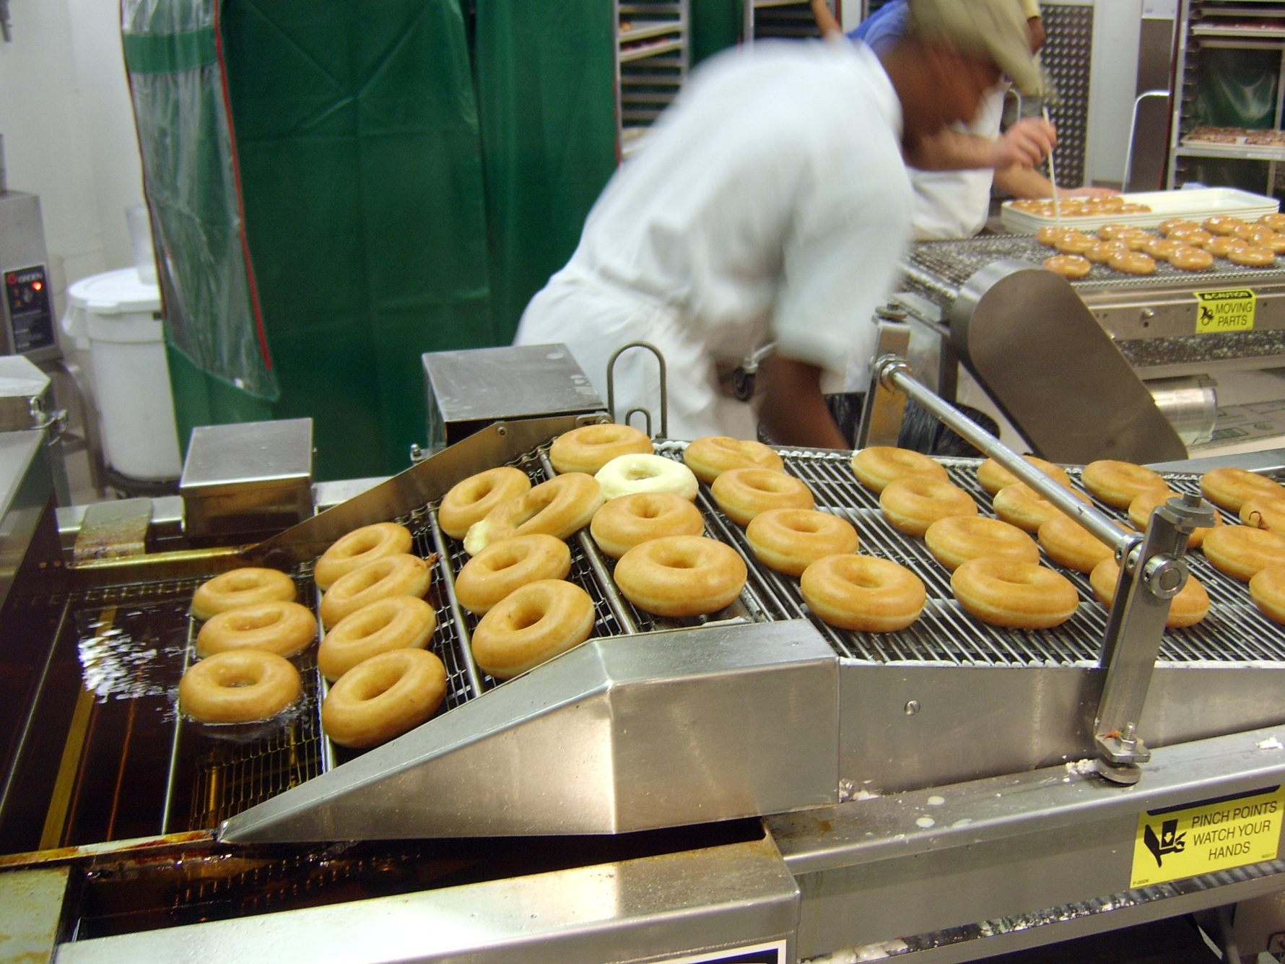
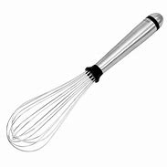
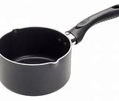
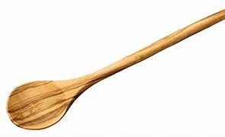
Cycle | Content | Skills
2 | Oaty biscuits practical Healthy eating Mexican chicken practical Cooking chicken safely Commercial food production Chicken goujons practical | The melting method of baking Food groups and examples Pathogens and food preparation Manufacturing and knife skills Batch food production Production line organisation
KS3 Knowledge Organiser: Y7 Food Technology
Planning and Mass Production
Key words
Manufacture/ Production – To follow various steps to make a product. Production Line – An arrangement in a factory where an item being manufactured is passed through a set linear sequence of mechanical or manual operations. Quality – How well an item is made. Pathogens – Organisms that can cause disease. The 4 C’s - Chilling – To keep food chilled/refrigerate. Cooking – To cook raw meat thoroughly. Cleaning – To clean surfaces and equipment thoroughly. Cross Contamination – Mixing raw and cooked foods on the same surface.
Key skills
Manufacturing: Using key manufacturing skills safely and practicing to develop your skill and accuracy so that the products you make are high quality. In Food Technology this includes knife skills, using a range of heating equipment such as cookers, hobs and microwaves as well as measuring equipment to manufacture different recipes.
Pathogens and food preparation: A pathogen in the oldest and broadest sense, is anything that can produce disease. A pathogen may also be referred to as an infectious agent, or simply a germ. The 4 C's can help to minimise pathogens.
Chilling: Leftover food needs to be handled and stored safely so that it does not pose a food safety risk, if there are leftovers after serving, place on a clean plate, cover and refrigerate within two hours.​ | Cooking: As all raw meats can carry harmful bacteria on the outside, it is important to cook all meat properly to kill the bacteria that can cause food poisoning.​
Cleaning: Regular cleaning of worktops, chopping boards and any surfaces that come into contact with food is important to prevent the spread of bacteria. Proper cleaning requires hot soapy water and a good scrub.​ | Cross contamination: When bacteria is spread by other foods or dirty hands from one surface to another.​
Production lines: A production line is a set of sequential operations in a factory where components are assembled to make a finished product that is suitable for onward consumption.
Practical: Chicken should be white in the middle when fully cooked.
Curriculum Links
Literacy: specification writing, design communication, key words. Numeracy: Portion control, weighing, measuring, budgeting, Careers/Cultural Capital: Looking at local and cultural foods, hospitality and catering skills. BBC bitesize links Automated production of bottles https://www.bbc.co.uk/bitesize/clips/z2v2tfr Chilling Broccoli https://www.bbc.co.uk/bitesize/clips/z4pd7ty
Key knowledge
Carbohydrates are starchy or sugary foods which give lots of energy. Examples of this food type are bread, potatoes and pasta. Try to eat more starchy foods than sugary ones!​
Proteins help the body to make and repair muscle. Too little of this food group can cause slow growth. Examples of this food type are meat and fish.​
Water is vital to keep our bodies hydrated. Recommended you drink 8 glasses a day! Its also in fruit juices.​
Fats give some energy but less than carbohydrates. They are used to keep the body warm. Examples of this food type are butter and oil.​
Vitamins and Minerals keep our bodies healthy and protect us from illness. Lots of these are found in fruit and vegetables or you can take them as a tablet too!​
Fibre helps to keep your gut healthy and make sure you absorb the nutrients in your food. You can get lots of Fibre from foods such as cereal and brown pasta.​
Picture | What is it called? | When is it used?
 | Knife and Chopping Board | It is used to cut up food for cooking.
 | Scales | It is used to measure out ingredients that you are cooking with.
 | Saucepan | This is used to boil water which you will then cook your food in.
Picture | What is it called? | When is it used?
 | Tea Towel | It is used to dry equipment when it has been washed.
 | Whisk | This is used to mix ingredients together when cooking.
 | Wooden Spoon | This is used to mix ingredients together when cooking.

Slide 3
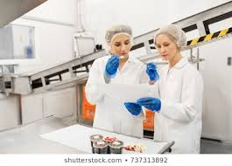
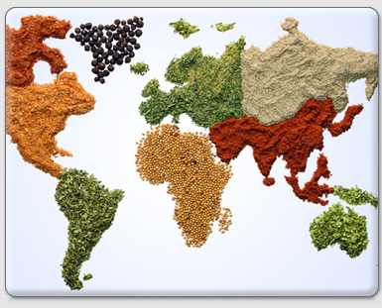
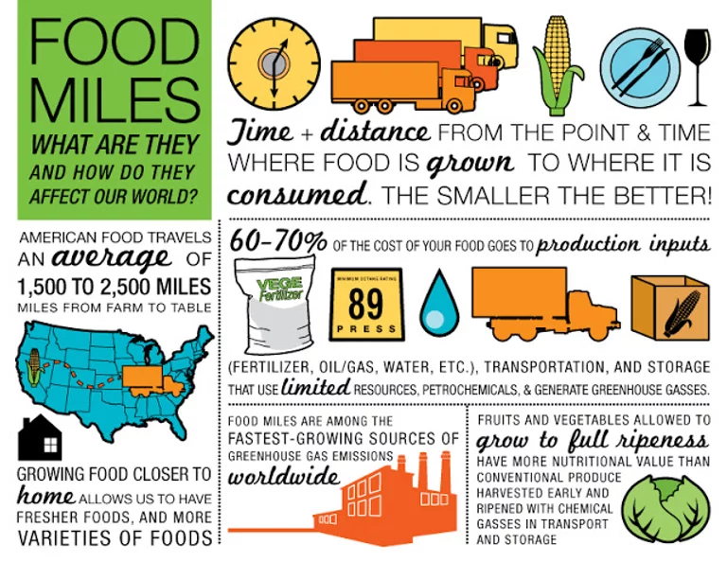
Cycle | Content | Skills
3 | Curry practical Testing and evaluating Curry practical Bolognese practical Meal planning and budgeting End of year assessment | Appreciating cultural foods Analysing and evaluating Recognising cultural foods Cost analysis/Rationing and portion control Retention of key knowledge
KS3 Knowledge Organiser: Y7 Food Technology
Designing and Evaluating
Key words
Cultures – A persons belief, knowledge, art, morals, law, custom. Testing – To test an item after it has been made. Evaluating – To give positives, negatives and a summary about a product. Feedback – To give another opinion about a product. Reflecting – To review a product or situation to see if it can be improved. Food Miles – How far food has travelled before getting to the supplier or customer. Savoury – A food that is salty or spicy. Sweet – A food that contains sugars or sweeteners. Taste – How a food tastes. Texture – How a food feels.
Key skills
Testing and Evaluating: By comparing your finished product with the specification and also by asking for 3rd party feedback, you can identify strengths and weaknesses with the design and manufacture of the item. You can use this information to suggest ways it could be improved or developed in the future.
Appreciating cultural foods. Some of the UKs favourite food comes from all over the world Italy – pizza , pasta and coffee. China – peking duck, prawn crackers and sweet and sour. France – macarons , cakes and baguette. India - curry, nan bread and dal. America – burgers, fries and BBQs. Imagine how boring our food choices would be without the influences we take from other cultures.
Cost analysis The weekly food allowance for a single person in their latest report is £46.31. I try and budget for around £40 per week, out of a total household allowance of £60. Portion control is important because it allows you to have a tight handle on how many calories you are consuming. This way, you eat what your body needs, instead of mindlessly overindulging. | PRICE FLUCTUATIONS. SEASONALITY. CONTAINER SIZE. STORAGE TEMPERATURE. TRANSPORT COSTS. FUEL COSTS. LOCATION OF FOOD.
Practical When cooking curry the spice content can be altered to taste as well as the thickness of sauce by adding cream.
Curriculum Links
Literacy: specification writing, design communication, key words. Numeracy: Portion control, weighing, measuring, budgeting, Careers/Cultural Capital: Looking at local and cultural foods, hospitality and catering skills. BBC bitesize links How noodles are made.https://www.bbc.co.uk/bitesize/clips/zjbxpv4 How prawn crackers are made. https://www.bbc.co.uk/bitesize/clips/zmchfg8
Key knowledge
Being able to describe the taste and texture of food is very important. Here are some examples. Bitter - Having a strong, often unpleasant taste e.g. coffee, dark chocolate. Sweet - Usually an enjoyable taste of sugar, Dry - Not wet. Moist - A little wet. Bland - Boring, not interesting. Spicy - Having strong flavours from spice. Savoury - Not sweet e.g. bread. Rich - Rich food has a lot of butter, cream, or eggs in it. Salty - Tastes of salt. Tasty - Good flavour and is nice to eat. Sugary - Tastes of sugar. Greasy - Containing or covered with fat or oil. Scrumptious - delicious. Sour - Having a sharp taste e.g. yogurt, lemon. Piping hot -Very hot. Crunchy - Firm and making a loud noise when it is eaten.
Often many of our foods have come from lots of different countries. 9 Tips to Reduce Your Food Miles Shop Local Eat Seasonally Think About the Transport Method Use Farmer’s Markets and Local Small Stores Buying in bulk Cook From Scratch Eat Less Meat Don’t Drive to the Shops Grow Your Own food

