Slide 1
Engineering
St Joseph’s Catholic Academy
Welcome to the Engineering Course

Slide 2
KS5 - Level 3 Engineering
Course Structure BTEC Engineering – Extended Certificate 360 Guided Learning Hours (equivalent to 1 A-Level) 4 Units across 2 years 2 Externally Assessed Units Unit 1 – 2hr Formal Exam Unit 3 – 6hr Assessment under Exam Conditions 2 Internally Assessed Units Unit 2 & Unit 9 Controlled Assessment | Units Unit 1 Engineering Principles Unit 2 Delivery of Engineering Processes as a Team Unit 3 Engineering Product Design and Manufacture Unit 9 Work Experience in the Engineering Sector
What do we do? Unit 1 Learning to apply key mathematic and physics principles to engineering problems. Unit 2 Planning and manufacturing an engineering product as a manufacturing team. Unit 3 Identifying the key criteria for successful engineering design and producing appropriate design solutions and planning. Unit 9 Carrying out a period of work experience at a chosen company to gain industry specific skills and experience. | Career Links University courses in any field of Engineering Apprenticeships in any field of Engineering E.g. Mechanical, Civil, Biomedical, Marine, Automotive, Aerospace, Agricultural, Catering, Communications, Aeronautical…

Slide 3
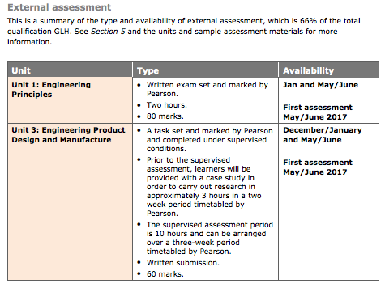
COURSE OUTLINE
external assessment
Assessment
Assessment is specifically designed to fit the purpose and objective of the qualification. It includes a range of assessment types and styles suited to vocational qualifications in the sector. There are three main forms of assessment that you need to be aware of: external, internal and synoptic.
Externally-assessed units
Each external assessment for a BTEC National is linked to a specific unit. All of the units developed for external assessments are of 90 or 120 GLH to allow learners to demonstrate breadth and depth of achievement. Each assessment is taken under specified conditions, then marked by Pearson and a grade awarded. Learners must achieve all external units at pass grade or above. Learners are permitted t resit any external assessment only once during their programme.
The styles of external assessment used for qualifications in the Engineering suite are:
Examinations – all learners take the same assessment at the same time, normally with a written outcome.
Set tasks – learners take the assessment during a defined window and demonstrate understanding through completion of a vocational task.

Slide 4
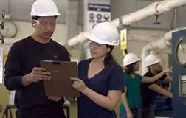
COURSE OUTLINE
Internally Assessed Coursework
UNIT 2: DELIVERY OF ENGINEERING PROCESSES SAFELY AS A TEAM
Learners explore how processes are undertaken by teams to create engineered products or to deliver engineering services safely. Then examine how they might build and create products within their own teams and the processes used.
UNIT 9 WORK EXPERIENCE IN THE ENGINEERING SECTOR
Learners set up, arrange, and explore avenues of employment they might be interested in pursuing a career in. Enabling networking and building contacts within the industry for the future whilst also building important communication skills.

Slide 5
“I loved getting to use some of the bigger equipment and get to be more independent as we didn’t get to do that in lessons before.”
What our students say about the course.
“I didn’t think I would enjoy the work experience part but since I chose and organised it I got a chance to see what it would be like to do the type of job I’m interested in.”

Slide 6
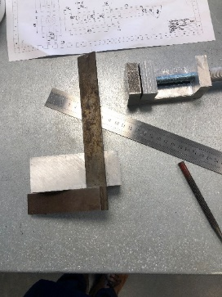
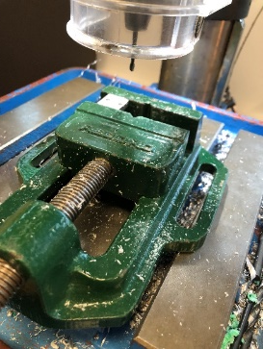
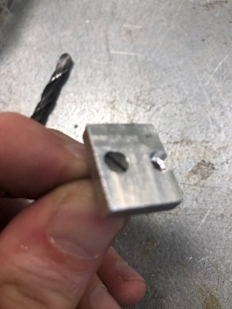
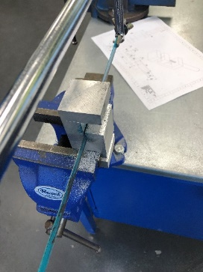
Why study Engineering at St Joseph’s?
2020 100% Pass rate.
Large facilities with access to many pieces of engineering equipment, including Lathe, Vertical Mill, Laser Cutter, Forge, Spot/Mig Welder along with many others.
Great opprtunities for employment or further study once complete.

