Slide 1
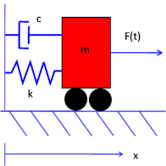
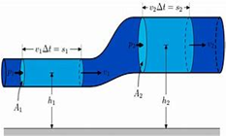
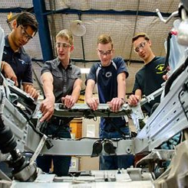

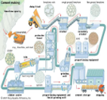
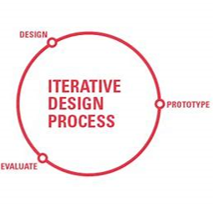

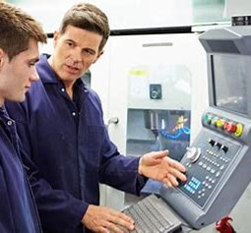


Read like an engineer…
Year 12: Sustainable Energy – Without the Hot Air
David J.C. MacKay
Engineering: A Beginner's Guide
Natasha McCarthy
The Gecko’s Foot: How
Scientists are Taking a Leaf
from Nature’s Book
Peter Forbes
Year 13:Engineer to Win
Caroll Smith
An Astronaut’s Guide to Life
Chris Hadfield
Sustainable Materials – With Both
Eyes Open Julian Allwood and
Jonathan Cullen
Learning Journey
12-13
BTEC Engineering
Careers Links
Year 12: engage with issues, organisation and personal responsibility, creativity, collaborative working, contextual analysis
Year 13: evaluate skills, monitor performance, drive own project, problem solve, explain reasoning.
Engineering Principles
Algebraic and trigonometric mathematical methods
Static engineering systems
Dynamic engineering systems
Delivery of a process safely as team
Common engineering processes
Health & safety
Human Factors
Principles of engineered drawings
Engineering Product design and manufacture
Design triggers and challenges
Equipment & system constraints and opportunities
Material properties
Mechanical power transmission
Manufacturing processes
Work experience in the engineering sector
Developing skills and attributes
Clarifying expectations for employment in engineering
Exploring career options
Revision
Engineering principles
Engineering systems
Iterative design process
Engineering systems
Fluid and thermodynamic
Static and direct current electricity and circuits
Magnetism and electromagnetism
Single phase alternating current
Manufacture
Principles of effective teams
Team set-up and organisation
Health & safety risk assessment
Batch manufacture
Delivery of an engineered service
Design process
Regulatory constraints and opportunities
Market, Performance and Manufacturing analysis
Design proposals
Iterative development process
Statistical methods
Validating designs
Work experience
Work shadowing and observations
Reviewing personal and professional development
Using feedback and action planning
Exams
Unit 1: Engineering Maths exam
Unit 3: Supervised set design engineering task to a brief
On to university, apprenticeship or employment…

