Slide 1
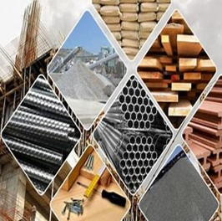

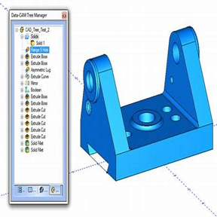

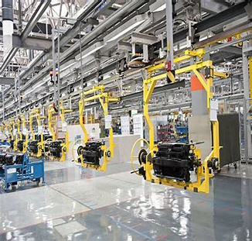
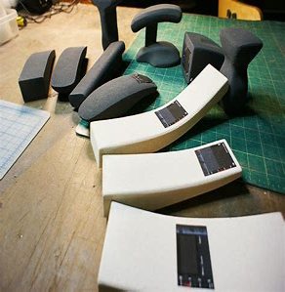
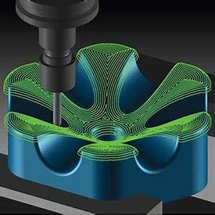
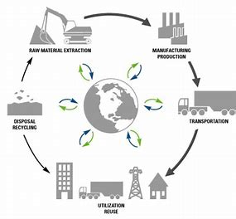


Read like a designer…
Year 12: Mortal Engines Philip Reeve
How to Fail at Almost Everything and
Still Win Big Scott Adams
How Do Wings Work? Holger
Babinsky
Year 13:Cats' Paws and
Catapults: Mechanical
Worlds of Nature and People
Steven Vogel
Structures – or Why Things
Don’t Fall Down J.E. Gordon
The Design of Everyday Things
Don Norman
Learning Journey
12-13
Design Technology
Careers Links
Year 12: Cognitive thinking, problem-solving critical thinking, expert and creative solutions, use systems and technology. Communicating, working collaboratively, negotiating and influencing, self-presentation
Year 13: self-management, adaptability and resilience, self-monitoring and development, learn independently, research actively and methodically, analytical and problem-solving skills.
Orientation from GCSE to A level
Materials and their applications
Research
Product analysis
Performance characteristics of materials
Questionnaires and the importance of 3rd party feedback
Design
Client
Accuracy in design
Design for manufacture and Environment
Enhancement of materials
Computer aided design
Development
Modern and industrial commercial practise
Digital design and manufacture Enterprise/marketing in the development off products
Manufacture
Manufacture and project management
Computer aided manufacture
Scales of production
Revision
Design cycle principles
Product and materials impact
Manufacturing Techniques
Impact
How technology and cultural changes can influence design
Responsible designing
Health & safety
Selecting appropriate tools, materials and processes
Testing
Prototypes
Working models
Client analysis
Modification
Evaluation
Analysis of production cycle
Feasibility studies
Product improvements
Modern manufacturing systems
Exams
Product Design Paper1
(Technical principles)
Product Design Paper 2
(Design and making principles)
On to university, apprenticeship or employment…

