Slide 1
Year 9 Scheme of Learning
MODULE 3

Slide 2
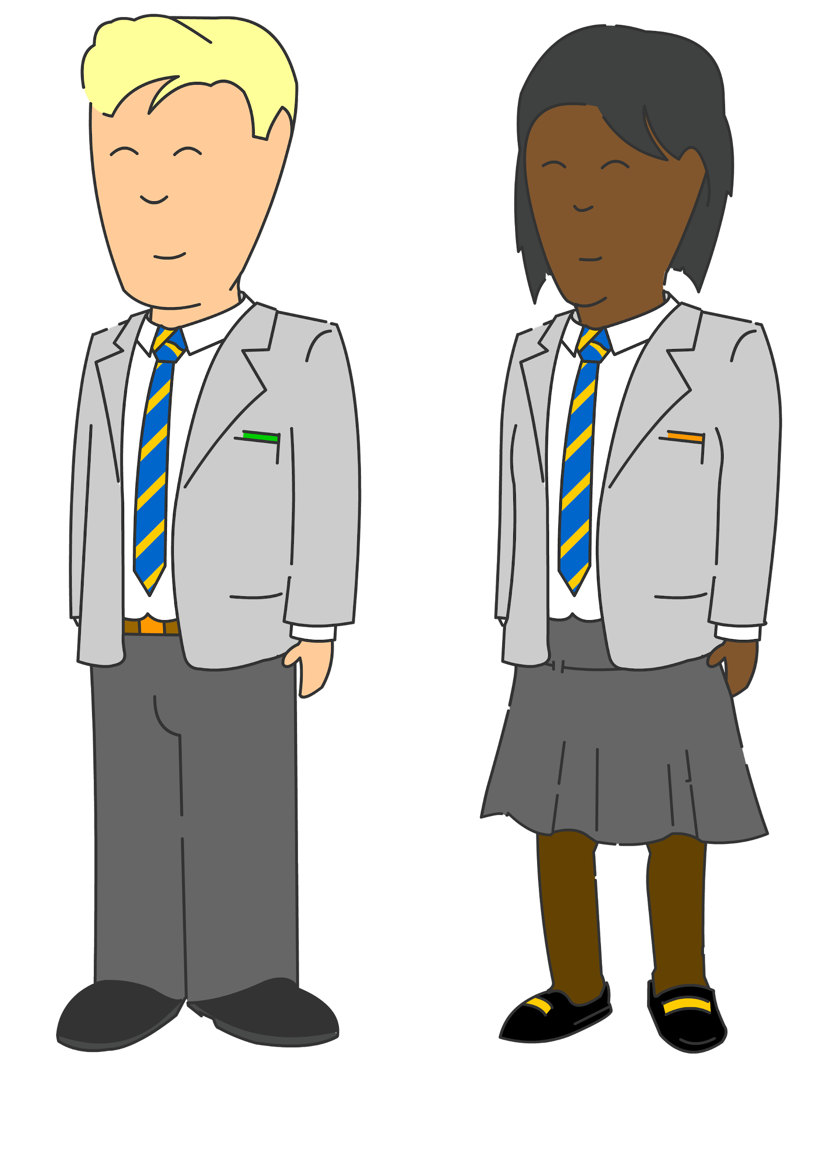
Bounce back: Constructions & Loci
Bespoke revision
Perimeter, area & volume
Quadratic equations
Compound measures
Year
11
Percentages, including interest
GCSE EXAMS
Indices & standard form
Bounce back: Quadratic equations
Constructions & Loci
Probability & diagrams
Perimeter, area & volume
Averages
Angles & Transformations
Straight line & other graphs
Expressions & equations
Graphs
Year
10
Pythagoras & Trigonometry
Fractions & percentages
Sequences
Pythagoras & Trigonometry
Ratio & proportion
Data handling
Handling data & measures of location
Angles in parallel lines, lines & polygons
Fractions & percentages
Algebra: including substitution & brackets
Year
9
Sequences & Indices
Number; including index laws
Area of trapezia & circles; Line symmetry & reflections
Standard form & number sense
Brackets, equations & inequalities
Sets & probability
Proof
Multiplicative reasoning
Working in Cartesian plane
Ratio & proportion
Year
8
Representing data, tables & probability
Fraction arithmetic
Prime numbers
Ratio & scale
Multiplying & dividing fractions
Geometric reasoning
Fraction & % of amounts
Fractions, decimals & percentages
Use and understand algebraic notation
Place value and ordering, including decimals
Operations with equations & directed numbers
Year
7
Problem solving with four main operations
Equality & Equivalence - solving equations
Sequences
Core/Foundation 2021/22 (includes Y11 bounce back)

Slide 3
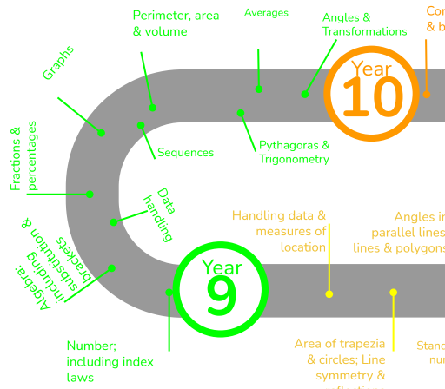
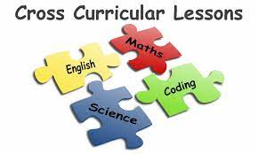
This is what your child will be taught in Year 9 in MATHS
They will have also have specific lessons linked to other subjects and a diet of retrieval built into their lessons
Notes:
MEntion cross curricular and retrieval lessons

Slide 4
In Year 9 Module 2 your child will study:
- Perimeter, area & volume - Pythagoras & trigonometry - Averages - Angles - Transformations

Slide 5
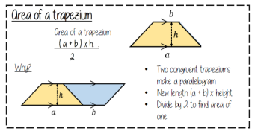
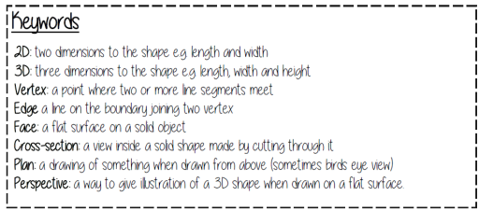
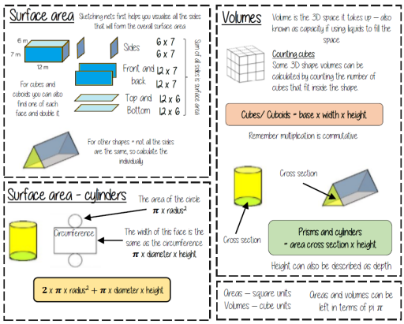
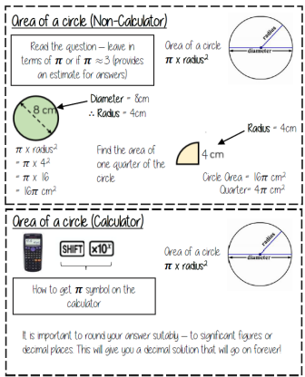
Unit 8: Perimeter, area & volume
Topics covered include:
Area and perimeter of quadrilaterals and triangles
Area and circumference of a circle
Surface area of cubes, cuboids and other prisms and pyramids
Volume of cubes, cuboids, prisms, and cylinders
Notes:
Discuss key areas of the Y7 SOL

Slide 6
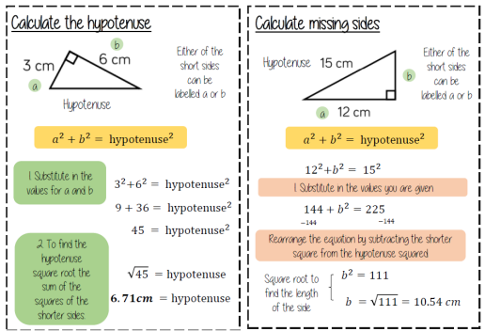
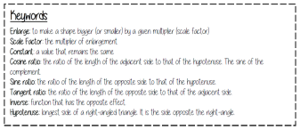
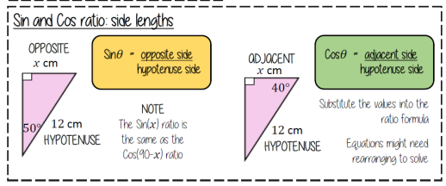
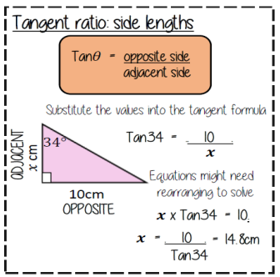
In this unit your child will study:
Topics covered include:
Using Pythagoras’ Theorem to find the hypotenuse or shorter side
Labelling sides of a right-angled triangle
Finding missing angles and sides in a right-angled triangle using trigonometry
Unit 9: Pythagoras & Trigonometry

Slide 7
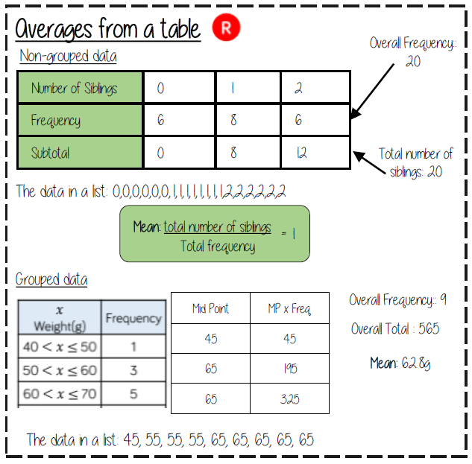
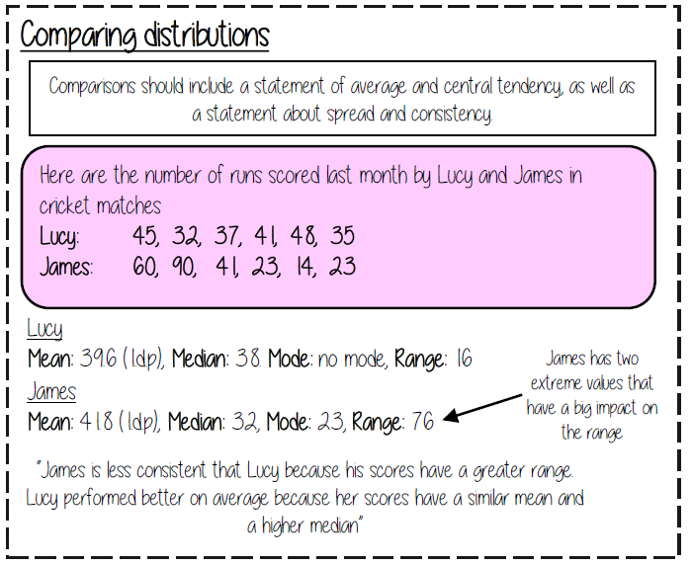
Unit 10: Averages
In this topic your child will study the
following:
All averages from a data set
All averages from a frequency table
Comparing data
Estimate the mean from a grouped frequency table
Notes:
Link sequences to graphs

Slide 8
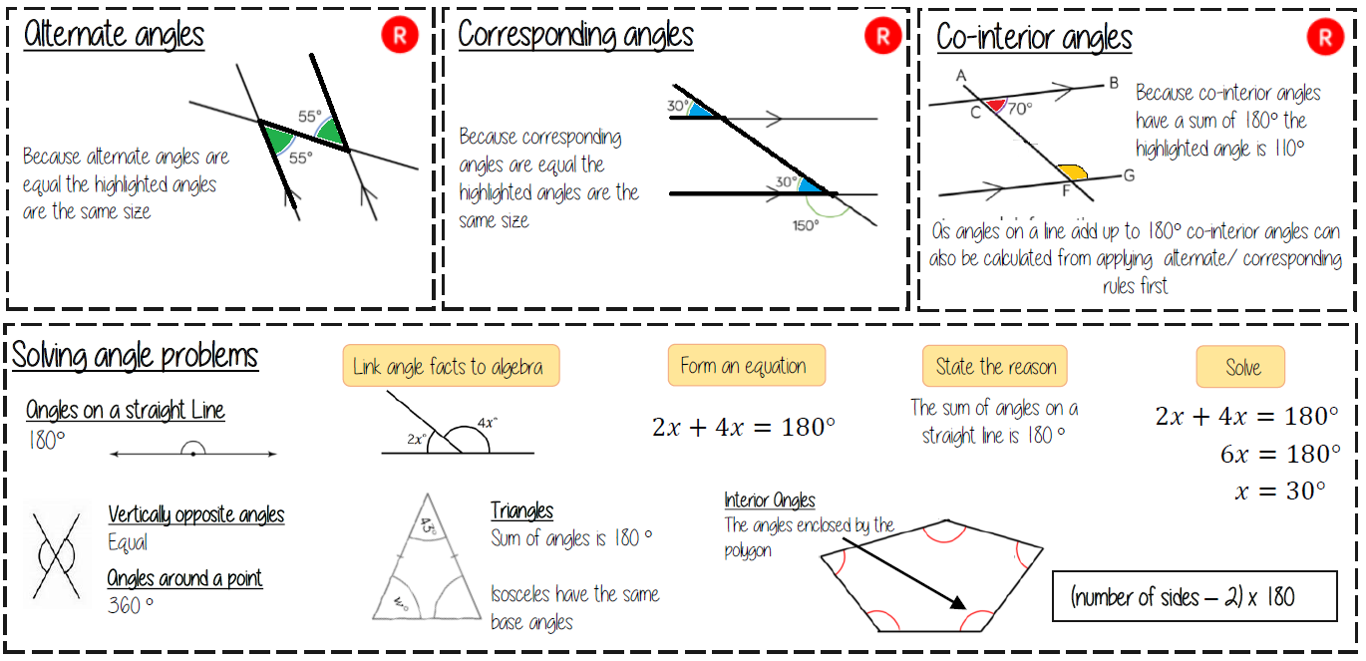
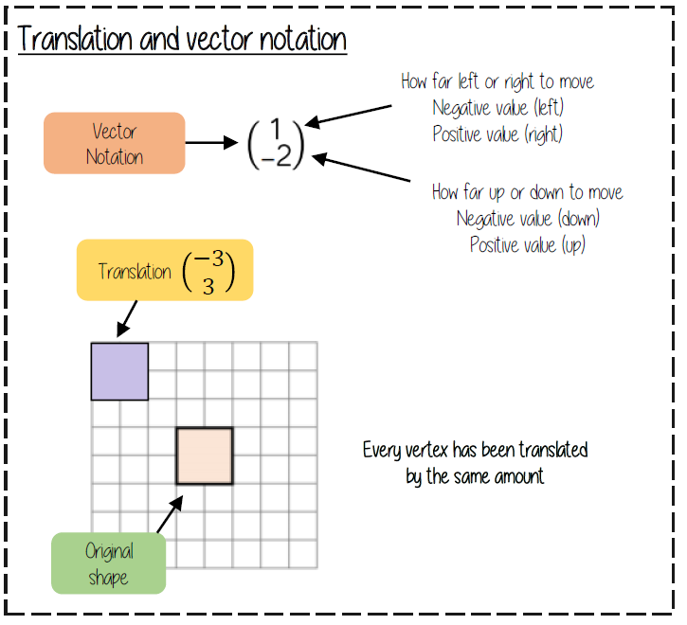
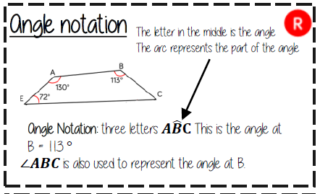
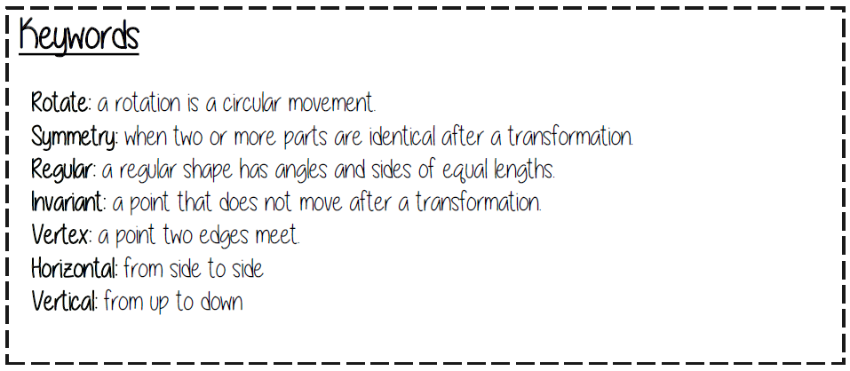
In this unit your child will study:
Basic angle facts
Angles in parallel lines
Interior and exterior angles in polygons
Reflections, rotations, enlargement and translations.
Unit 11: Angles & Transformations

Slide 9
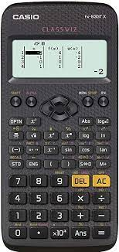
We recommend pupils have a Casio scientific calculator.
The Casio calculator featured is the one we use when demonstrating in lessons.

Slide 10
On our school website there is a calculation policy showing the methods we use for common operations.
It can be found at:
Our School > Policies

