Slide 1
Year 7 Scheme of Learning
Module 3

Slide 2
Bounce back: Constructions & Loci
Bespoke revision
Perimeter, area & volume
Quadratic equations
Compound measures
Year
11
Percentages, including interest
GCSE EXAMS
Indices & standard form
Bounce back: Quadratic equations
Constructions & Loci
Probability & diagrams
Perimeter, area & volume
Averages
Angles & Transformations
Straight line & other graphs
Expressions & equations
Graphs
Year
10
Pythagoras & Trigonometry
Fractions & percentages
Sequences
Pythagoras & Trigonometry
Ratio & proportion
Data handling
Handling data & measures of location
Angles in parallel lines, lines & polygons
Fractions & percentages
Algebra: including substitution & brackets
Year
9
Sequences & Indices
Number; including index laws
Area of trapezia & circles; Line symmetry & reflections
Standard form & number sense
Brackets, equations & inequalities
Sets & probability
Proof
Multiplicative reasoning
Working in Cartesian plane
Ratio & proportion
Year
8
Representing data, tables & probability
Fraction arithmetic
Prime numbers
Ratio & scale
Multiplying & dividing fractions
Geometric reasoning
Fraction & % of amounts
Fractions, decimals & percentages
Use and understand algebraic notation
Place value and ordering, including decimals
Operations with equations & directed numbers
Year
7
Problem solving with four main operations
Equality & Equivalence - solving equations
Sequences
Core/Foundation 2021/22 (includes Y11 bounce back)

Slide 3
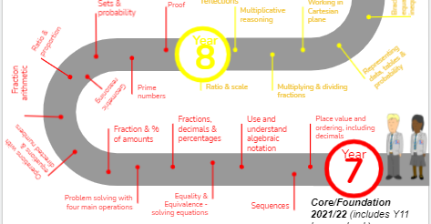
This is what your child will be taught in Year 7 in MATHS
They will have specific lessons linked to other subjects and a diet of retrieval built into their lessons
Notes:
MEntion cross curricular and retrieval lessons

Slide 4
The final topics of Year 7 are: - Constructions - Geometric reasoning - Sets & Probabilities - Prime numbers - Proof
We use the White Rose Maths scheme of learning in Year 7 as our feeder primary schools follow this scheme. It also helps with the transition to Year 7 as pupils are familiar with the resources.

Slide 5
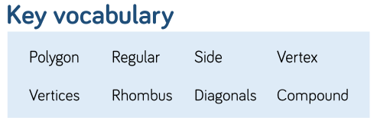
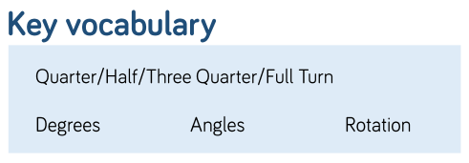
Unit 11: Constructions
Notes:
Discuss key areas of the Y7 SOL

Slide 6
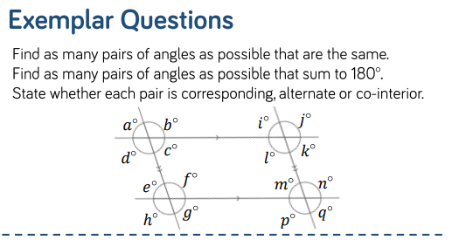
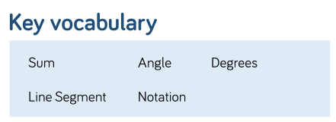
Unit 12: Geometric Reasoning
Notes:
Link sequences to graphs

Slide 7
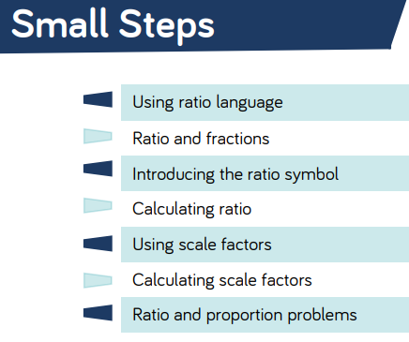
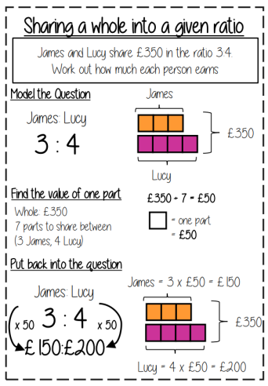
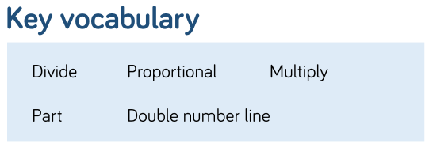
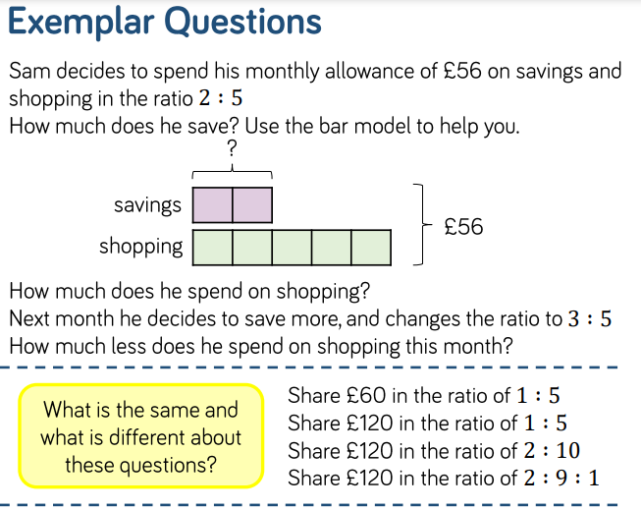
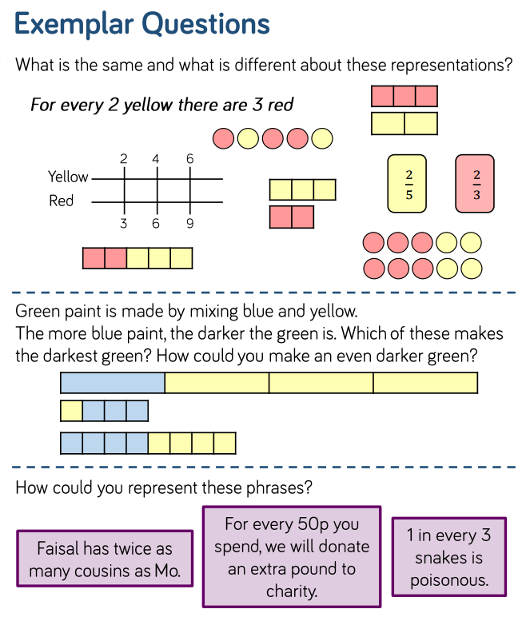
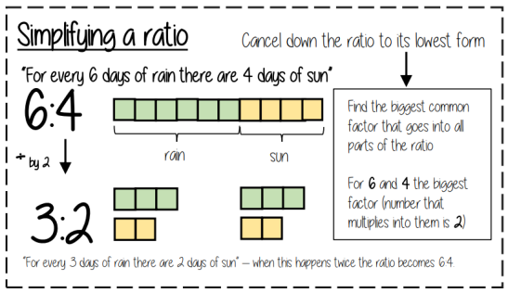
Unit 13: Ratio & Proportion

Slide 8
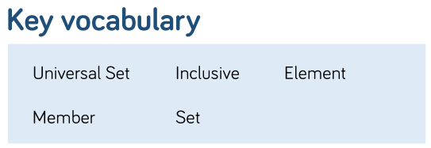
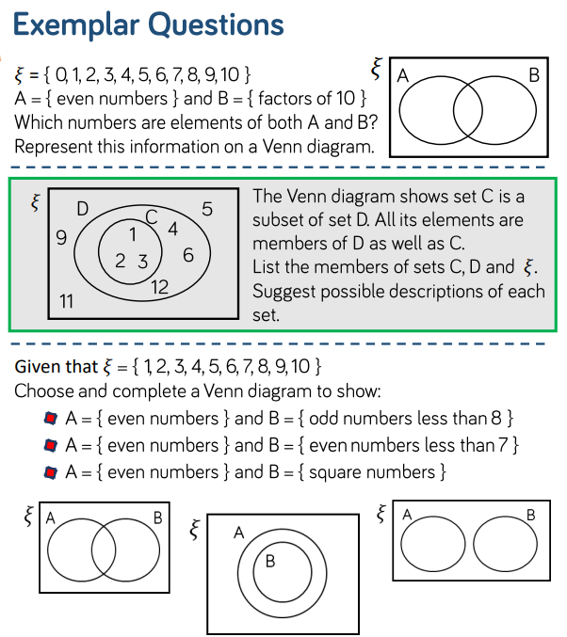
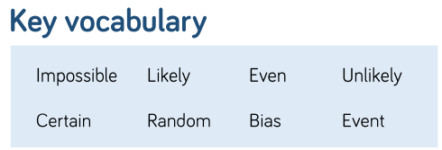
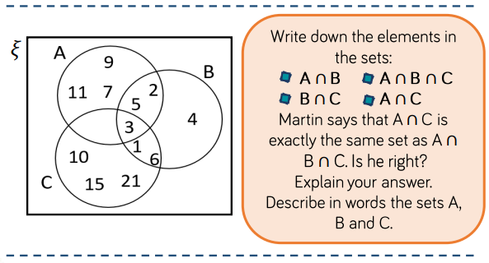
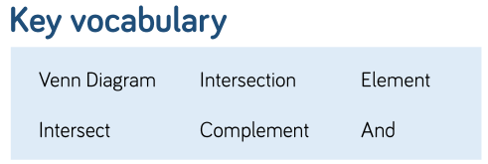
Unit 14: Sets & Probability

Slide 9
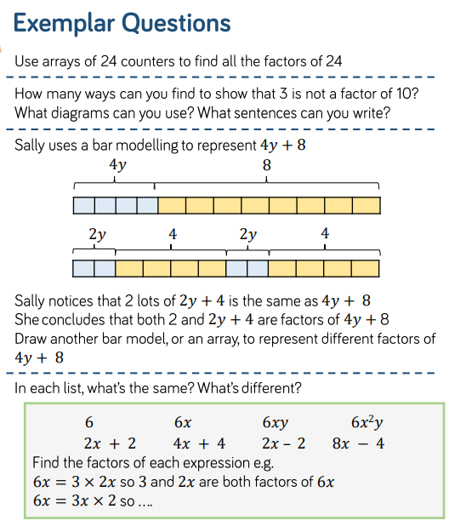
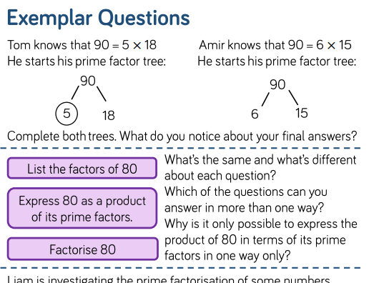
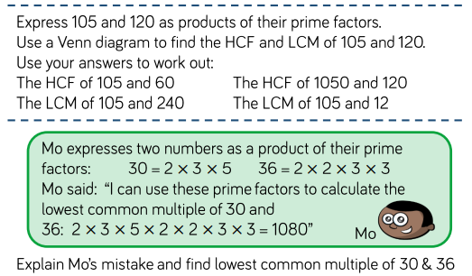
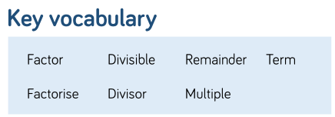
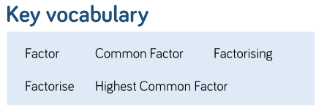
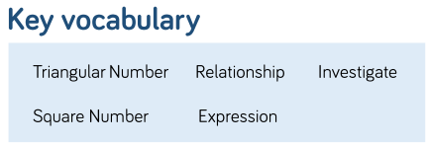
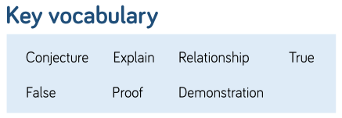
Unit 15: Prime Numbers

Slide 10
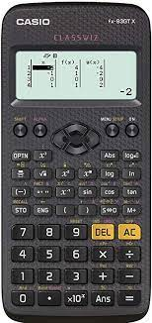
We recommend pupils have a Casio scientific calculator.
The Casio calculator featured is the one we use when demonstrating in lessons.

Slide 11
On our school website there is a calculation policy showing the methods we use for common operations.
It can be found at:
Our School > Policies

