Slide 1
Year 10 Higher Scheme of Learning
MODULE 3

Slide 2
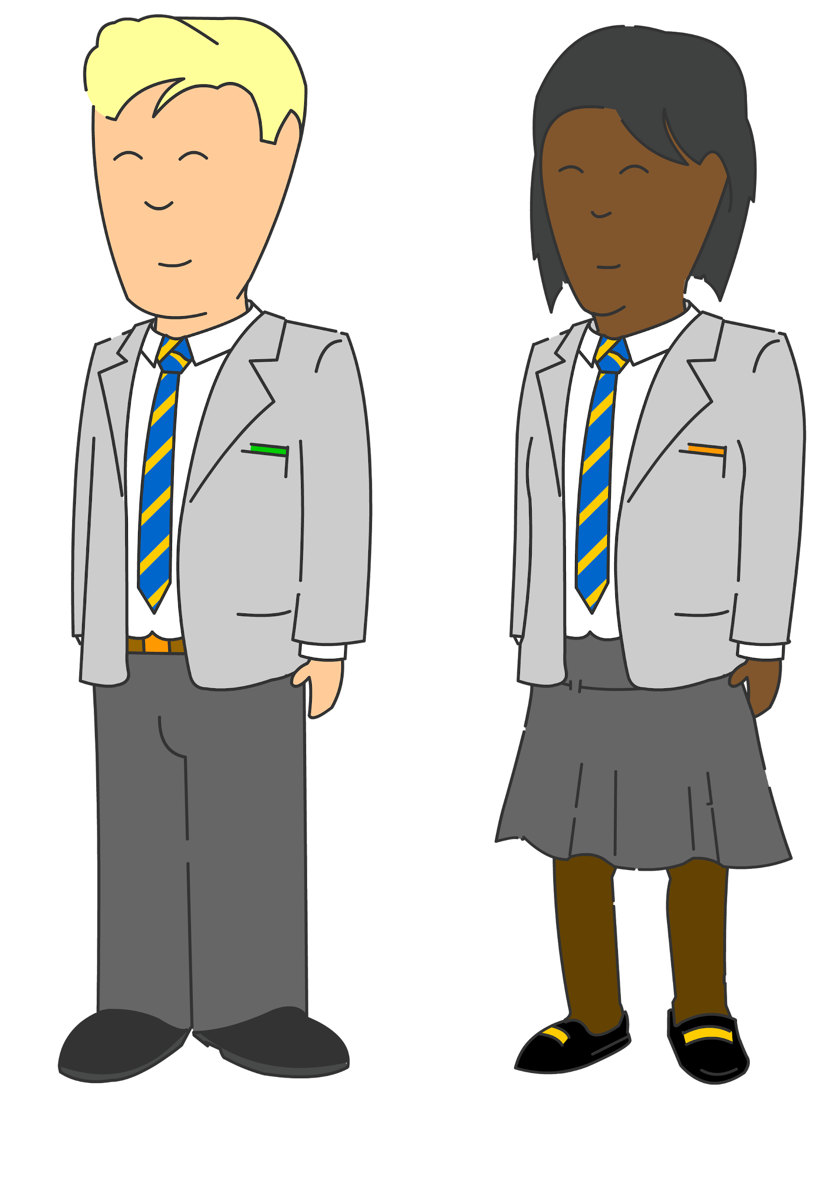
Vector notation
Circle theorems, equations & graphs
Bespoke revision
Functions & transforming graphs
Complex trigonometry
Year
11
Statistics
GCSE EXAMS
Construction & loci
Proportion & graphs
Functions & further algebra
Similarity & congruence
Perimeter, area & volume
Averages
Angles & Transformations
Constructions & bearings
Probability & diagrams
Graphs
Year
10
Proportion & compound measures
Fractions & percentages
Sequences
Pythagoras & Trigonometry
Equations, quadratics & Inequalities
Data handling
Handling data & measures of location
Angles in parallel lines, lines & polygons
Fractions & percentages
Algebra: including substitution & brackets
Year
9
Sequences & Indices
Number; including index laws
Area of trapezia & circles; Line symmetry & reflections
Standard form & number sense
Brackets, equations & inequalities
Sets & probability
Proof
Multiplicative reasoning
Working in Cartesian plane
Ratio & proportion
Year
8
Representing data, tables & probability
Fraction arithmetic
Prime numbers
Ratio & scale
Multiplying & dividing fractions
Geometric reasoning
Fraction & % of amounts
Fractions, decimals & percentages
Use and understand algebraic notation
Place value and ordering, including decimals
Operations with equations & directed numbers
Year
7
Problem solving with four main operations
Equality & Equivalence - solving equations
Sequences
Extend/Higher 2021/22 (includes Y11 bounce back)

Slide 3
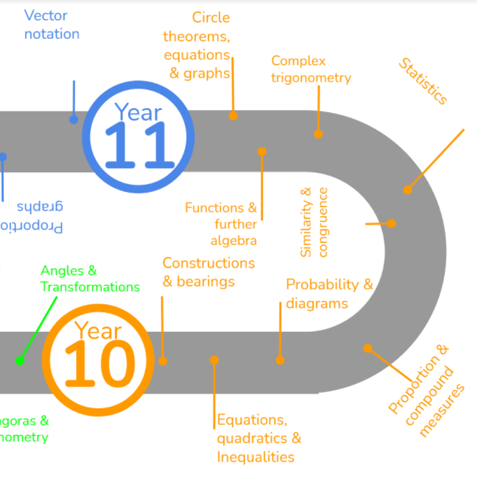
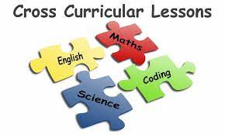
This is what your child will be taught as part of the GCSE higher course in Year 10 in their MATHS lessons.
They will have also have specific lessons linked to other subjects and a diet of retrieval built into their lessons.
Notes:
MEntion cross curricular and retrieval lessons

Slide 4
In Year 10 Module 3 your child will undergo their first set of GCSE mock exams as well as work experience. They will also study the following two large topics:
- Revision & feedback for mocks - Functions - Further algebra - Circle Theorems - Quadratic graphs

Slide 5
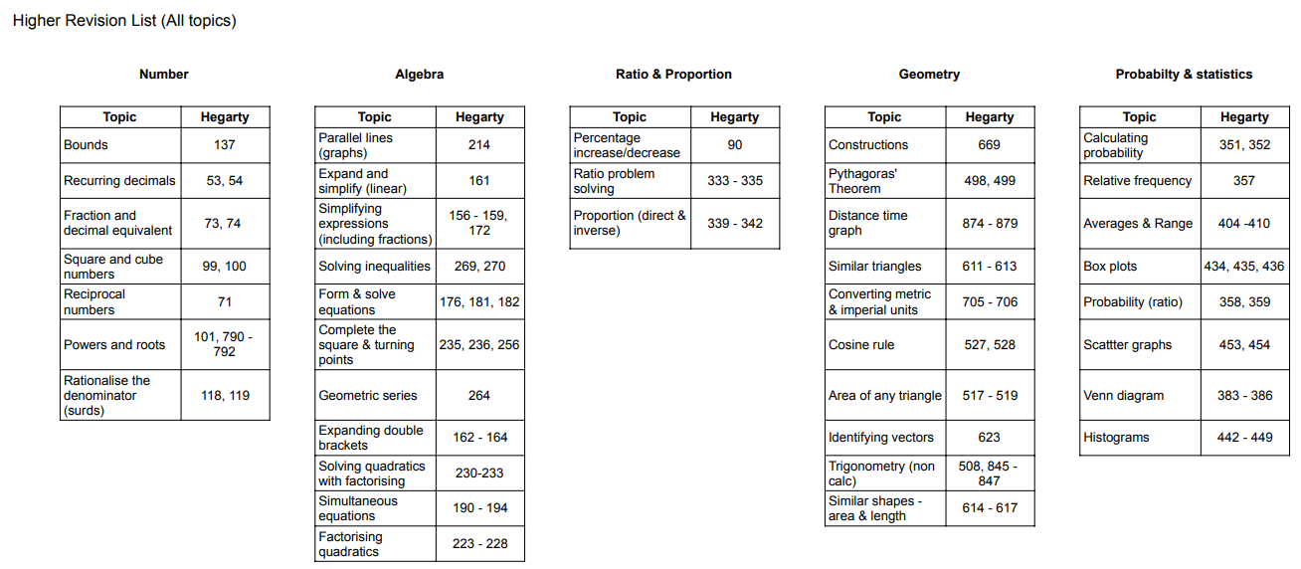
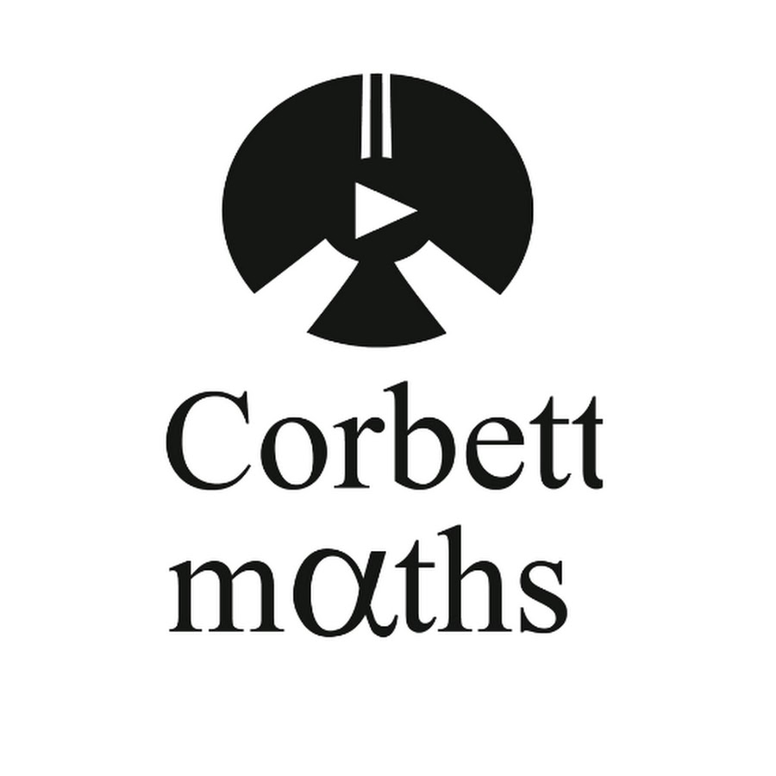
Revision for Mocks
Pupils have been given a 4 week revision plan to support their preparation for the mock exams, There are 4 revision tasks per week on Hegarty Maths.
In maths pupils will sit 2 papers – non calculator (1hr) and a calculator paper (1hr).
Other useful websites:
Corbett Maths
Onmaths
Maths Genie
BBC Bitesize
MathsMadeEasy

Slide 6
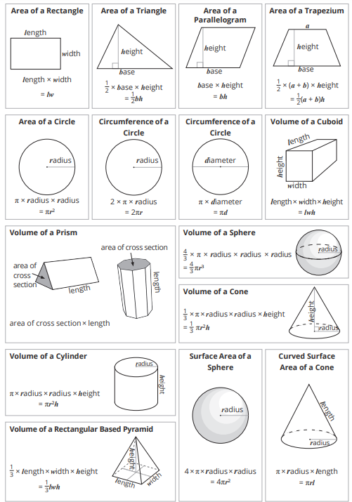
These are the common formulae that pupils need to learn.

Slide 7
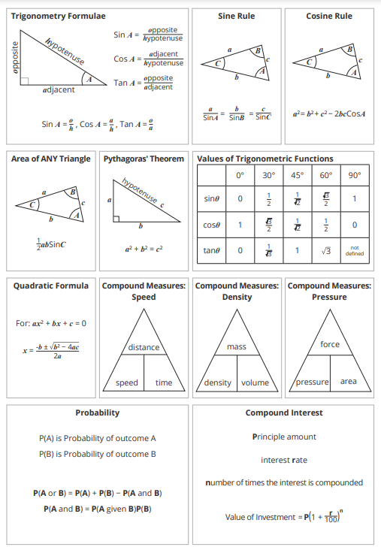
These are the common formulae that pupils need to learn.

Slide 8
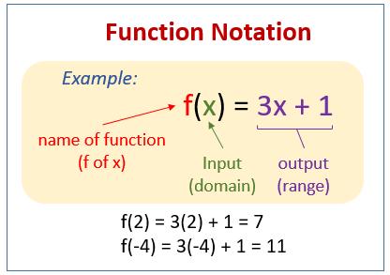
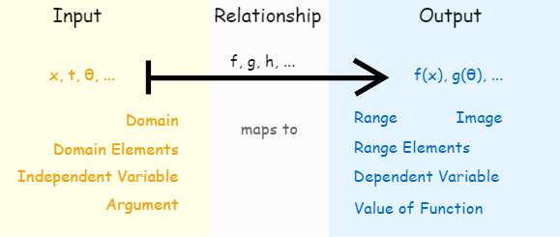
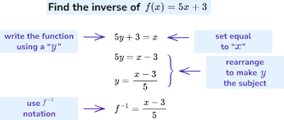
Functions
In this Unit students will learn
How to use function notation
To find and use composite and inverse functions

Slide 9
Further algebra
In this unit your child will study:
How to rearrange formulae
Simplify algebraic fractions
Solve equations with algebraic fractions
Use iteration

Slide 10
Circle Theorems
In this Unit students will study:
How to use circle theorems to find angles
Prove Circle Theorems

Slide 11
Quadratics
In this unit your child will study:
How to show inequalities on a graph
How to plot and use quadratic graphs
How to use quadratic graphs to find solutions

Slide 12
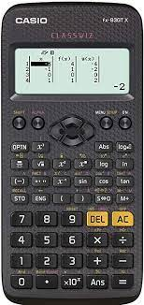
We recommend pupils have a Casio scientific calculator.
The Casio calculator featured is the one we use when demonstrating in lessons.

Slide 13
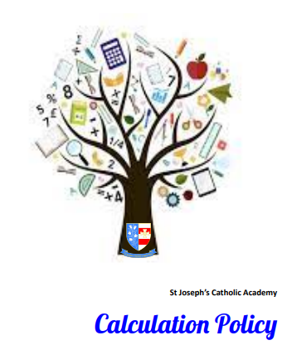
On our school website there is a calculation policy showing the methods we use for common operations.
It can be found at:
Our School > Policies

