Slide 1
Year 10 Foundation Scheme of Learning
MODULE 3

Slide 2
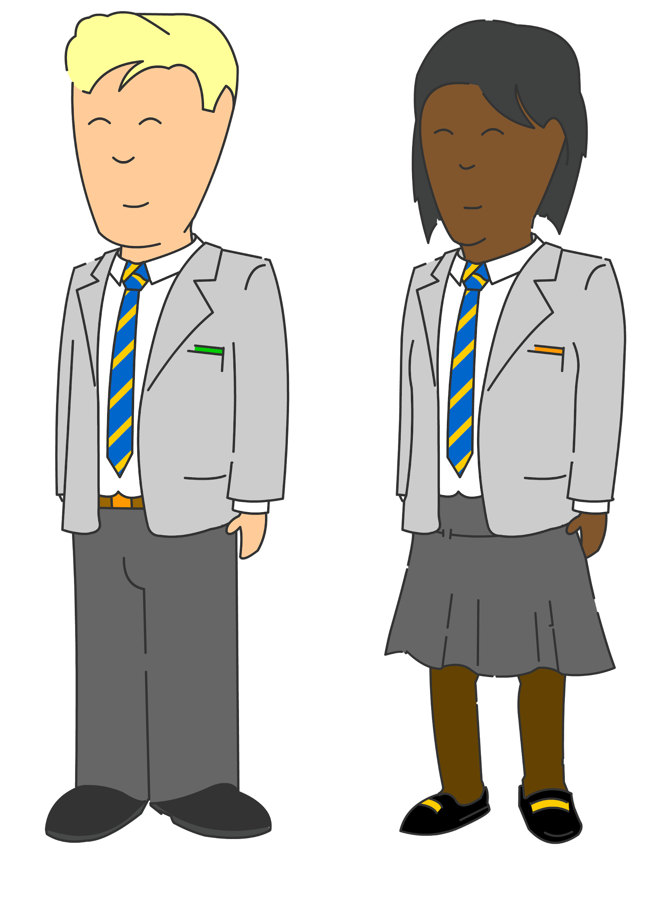
Bounce back: Constructions & Loci
Bespoke revision
Perimeter, area & volume
Quadratic equations
Compound measures
Year
11
Percentages, including interest
GCSE EXAMS
Indices & standard form
Bounce back: Quadratic equations
Constructions & Loci
Probability & diagrams
Perimeter, area & volume
Averages
Angles & Transformations
Straight line & other graphs
Expressions & equations
Graphs
Year
10
Pythagoras & Trigonometry
Fractions & percentages
Sequences
Pythagoras & Trigonometry
Ratio & proportion
Data handling
Handling data & measures of location
Angles in parallel lines, lines & polygons
Fractions & percentages
Algebra: including substitution & brackets
Year
9
Sequences & Indices
Number; including index laws
Area of trapezia & circles; Line symmetry & reflections
Standard form & number sense
Brackets, equations & inequalities
Sets & probability
Proof
Multiplicative reasoning
Working in Cartesian plane
Ratio & proportion
Year
8
Representing data, tables & probability
Fraction arithmetic
Prime numbers
Ratio & scale
Multiplying & dividing fractions
Geometric reasoning
Fraction & % of amounts
Fractions, decimals & percentages
Use and understand algebraic notation
Place value and ordering, including decimals
Operations with equations & directed numbers
Year
7
Problem solving with four main operations
Equality & Equivalence - solving equations
Sequences
Core/Foundation 2021/22 (includes Y11 bounce back)

Slide 3
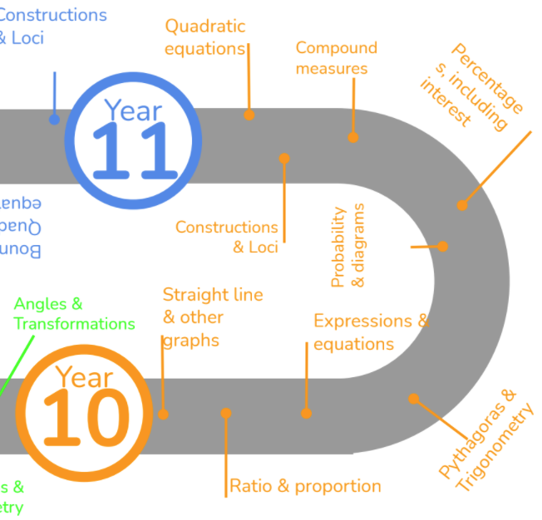
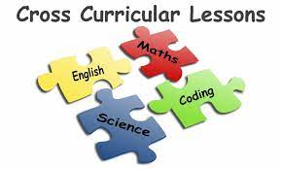
This is what your child will be taught as part of the GCSE foundation course in Year 10 in their MATHS lessons.
They will have also have specific lessons linked to other subjects and a diet of retrieval built into their lessons.
Notes:
MEntion cross curricular and retrieval lessons

Slide 4
In Year 10 Module 3 your child will undergo their first set of GCSE mock exams as well as work experience. They will also study the following two large topics:
- Revision and feedback for Mock examinations - Constructions & Loci - Quadratic Equations

Slide 5
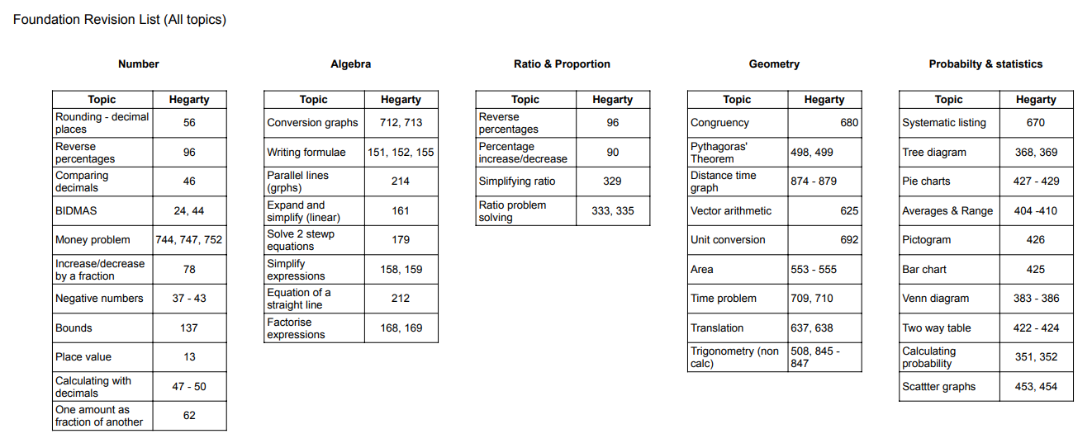
Revision for Mocks
Pupils have been given a 4 week revision plan to support their preparation for the mock exams, There are 4 revision tasks per week on Hegarty Maths.
In maths pupils will sit 2 papers – non calculator (1hr) and a calculator paper (1hr).
Other useful websites:
Corbett Maths
Onmaths
Maths Genie
BBC Bitesize
MathsMadeEasy

Slide 6
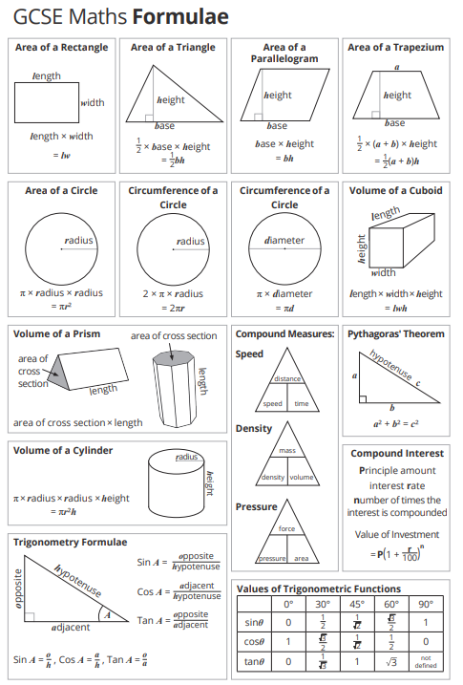
These are the common formulae that pupils need to learn.

Slide 7
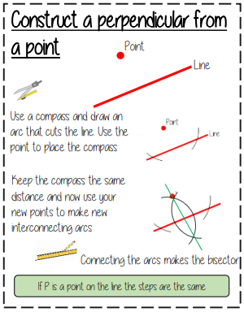
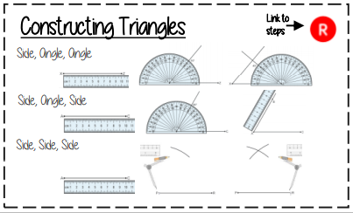
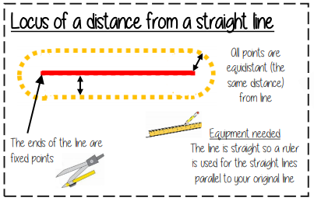
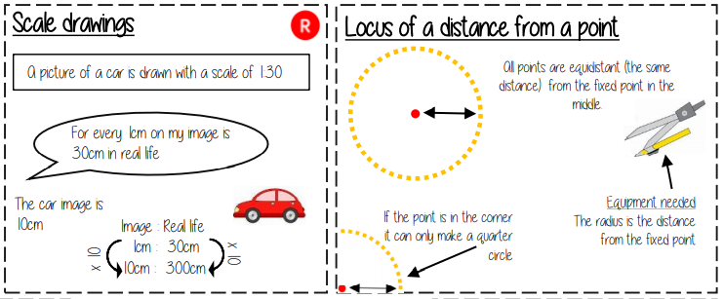
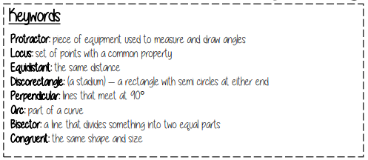
Constructions & Loci
Topics covered in this unit include:
Plans and elevations
Construct triangles and polygons
Construct perpendicular & angle bisectors
Loci
Bearings

Slide 8
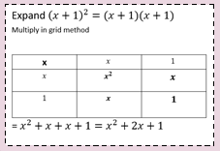
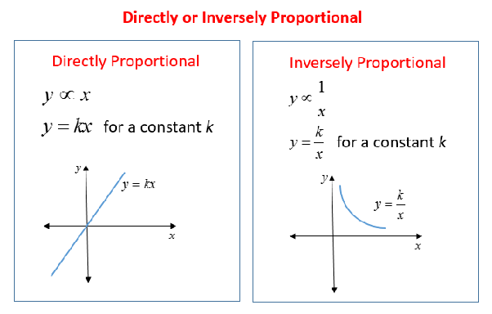
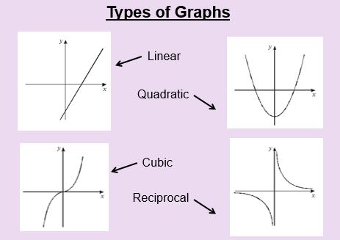
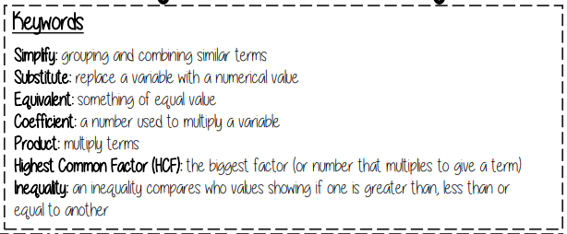
In this unit your child will study:
Expanding & factorising with double brackets
Solving quadratic equations by factorizing
Plotting & understanding quadratic graphs
Understand other types of graphs
Quadratic Equations

Slide 9
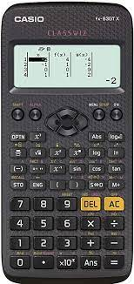
We recommend pupils have a Casio scientific calculator.
The Casio calculator featured is the one we use when demonstrating in lessons.

Slide 10
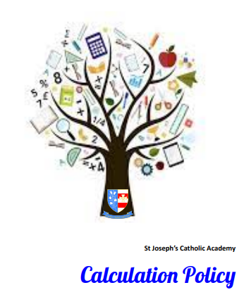
On our school website there is a calculation policy showing the methods we use for common operations.
It can be found at:
Our School > Policies

