Slide 1
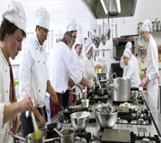
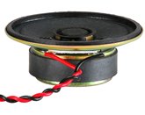
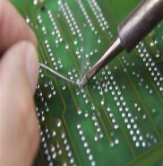
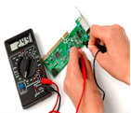
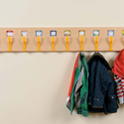
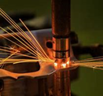
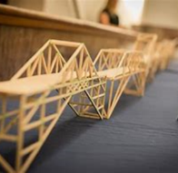
Learning Journey 7-9 Design Technology
Primary Threshold Concepts
Design – Make – Evaluate - Technical Knowledge
EYFS: Fruit Salad and Junk Modelling
KS1: Smoothies, Sandwiches, Moving Pictures, Patchwork
KS2: Fruit Crumble, Pasta,
Branding, Shoes, Pretzels, Curry, Fairground rides, phone cases.
Y7 Food Technology
Safe Food Preparation
Create and respond to a Design Brief for a Pizza product.
Develop a specification.
Healthy eating.
Preparing hot and cold dishes.
Analysis and Evaluation
Curry practical and evaluation.
3rd Party feedback.
Meal planning and budgeting.
Effective use of ingredients.
Bolognese practical.
Function of Ingredients.
Making
Oaty biscuits.
Understand functions of ingredients.
Cooking chicken safely.
Commercial food production.
Batch production chicken goujons.
Careers Links
Year 7: Catering in industry, Decision making, industrial processes, problem solving, research.
Year 8: Electronics in industry, creative thinking, planning
Year 9: Engineering in industry, machining, tolerances, quality control and management, accuracy.
Y8 Electronic Products
Materials and Design
Create and respond to a Design Brief for a clock.
Develop a specification.
Materials and processes.
Use and understand the vacuum former.
Practical and Soldering
What is electricity?
Using machinery safely.
Learning to solder effectively.
Components and their uses.
Analysis and Evaluation
Give and collect 3rd part feedback.
Final construction.
Testing and evaluation.
Y9 CAD & Engineering
Design and idea development
Create and respond to a Design Brief for a key ring for disabilities.
Develop a specification.
Materials and processes.
Use of modelling.
Practical and metal work
How are CAD programs used.
Drawing to scale.
Orthographic drawing.
Spot Welding.
Shaping and working with steel and aluminium.
Analysis and Evaluation
Give and collect 3rd part feedback.
Final construction.
Testing and evaluation.
Read like a designer…
Year 7: Gino's Italian Express​ Gino D'Acampo​
Year 8: ​​How to Fail at Almost Everything and Still Win Big Scott Adams
Year 9: Success Through Failure: The Paradox of Design Henry Petroski​
Extra-curricular and enrichment
Opportunities to enter design competitions.
Opportunities to visit national engineering and design events.
To KS4 – GCSE Product Design and BTEC Engineering…

