Slide 1
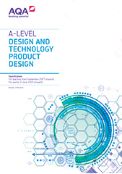
Product Design
St Joseph’s Catholic Academy
Welcome to the Product Design Course

Slide 2
A Level
Design Technology

Slide 3
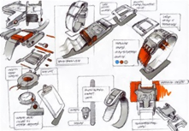
COURSE OUTLINE
Why choose A-Level Product Design?
This is a creative and thought-provoking qualification that gives you the practical skills, theoretical knowledge and confidence to succeed in a number of careers. Especially those in the creative industries.
You will learn to investigate historical, social, cultural, environmental and economic influences in design and technology, whilst enjoying opportunities to put your learning into practice by producing a product of your choice.
You will gain a real understanding of what it means to be a designer, alongside the knowledge and skills sought out by higher education and employers.
Non-Exam Assessment (NEA)
What’s assessed:
Practical application of technical principles, designing and making principles.
How it’s assessed:
Substantial design and make project.
100 marks
50% of A-level
Evidence:
Written or digital design portfolio and photographic evidence of a manufactured final product.

Slide 4
COURSE OUTLINE
Paper 1
What’s assessed:
Technical Principles
How it’s assessed:
2 hours and 30 minutes written exam.
120 marks
30% of A-level
Questions:
Mixture of short answer and extended response
Paper 2
What’s assessed:
Designing and Making Principles
How it’s assessed:
1 hour and 30 minutes written exam.
80 marks
20% of A-level
Questions:
Mixture of short answer and extended response
Broken down into 2 sections – Product analysis (30 marks) and commercial manufacture (50 marks).

Slide 5
“I enjoyed being able to design something I’m interested in instead of being told what I have to make.”
What our students say about the course.
“Getting to use different machines and more time to get good at them means I’m more confident.”

Slide 6
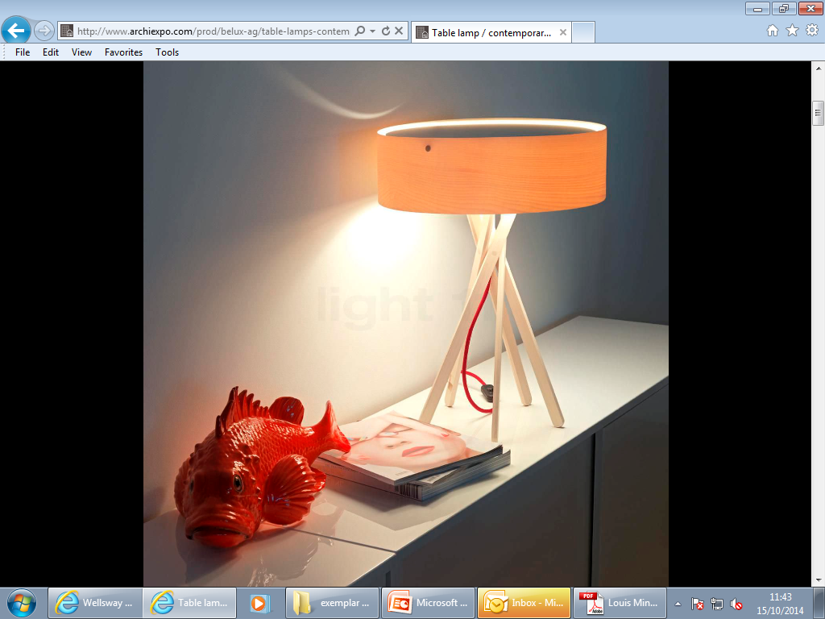
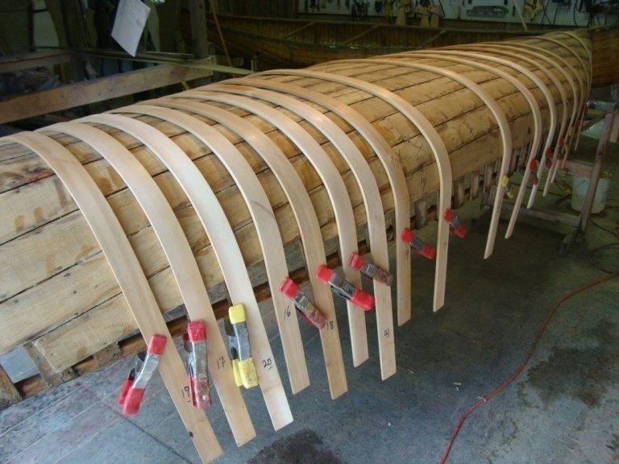
Why study Product Design at St Joseph’s?
2020 100% Pass rate.
Small class sizes.
Highly skilled staff to help your ideas come to life.
Large range of tools and machinery to be trained to use safely to create products. Including Laser Cutter and 3D printer.

