Slide 1

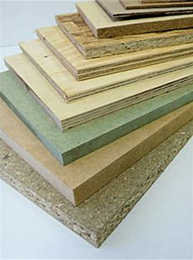
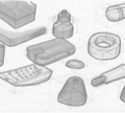
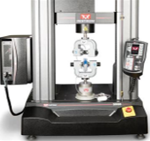

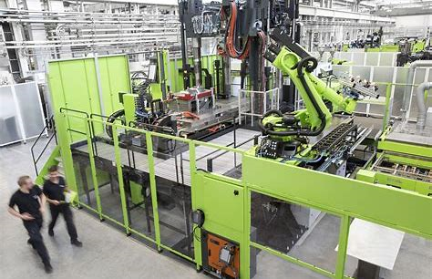

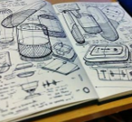


Learning Journey
10-11
Design Technology
Read like a designer…
Year 10: The New Science of Strong Materials –
or Why You Don't Fall Through the Floor
J.E. Gordon
Where Futures End
Parker Peevyhouse
Year 11: Success Through
Failure:
The Paradox of Design
Henry Petroski
Ready Player One Ernest Cline
Careers Links
Year 10: problem-solving, critical thinking, creative solutions, using systems and technology, communicating, working collaboratively, negotiating, influencing.
Year 11: self-management, adaptability, resilience, self-monitoring and development, active research, analytical and problem-solving skills
Core technical principles
New and emerging technologies
Energy generation and storage
Developments in new materials
Systems approach to designing
Designing
Basic sketching techniques
Using primary and secondary data
The work of other designers
How to produce a specification
Environmental, social and economic challenges
Design strategies
Specialist principles
Selection of material or components
Forces and stresses
Ecological and social footprint
Sources and origins
Tools & Equipment
Specialist techniques and processes
Surface treatments and finishes
Revision
Core principles
Design Process
Manufacturing processes and equipment
Materials
Mechanical devices
Materials and their working properties
Material properties
Making principles
Communication of design ideas
Prototype development
Testing materials, processes and components
Testing and evaluating
Modifying material
Using and working with materials
Stock forms, types and sizes
Scales of production
Project NEA
Using a brief to create a design portfolio
Evaluate and develop the design to the point of manufacture
Use a range of processes to create a final product
Examinations
Paper 1
•Section A: Core technical principles
• Section B: Specialist technical principles
• Section C: Designing and making principles
Extra-curricular and enrichment
Opportunities to enter design competitions.
Opportunities to visit national engineering and design events and examples of local industry
To A level and beyond

