Slide 1
Home Study – A Guide for Parents
Thank you very much for your support so far in encouraging your child to engage with their learning at home.
The ethos behind our online learning is that the systems that we put into place during the school closure ensure that all members of our school community feel supported throughout and beyond the period of closure, so that staff and students return to school mentally and physically healthy.
As you know, each subject sets tasks each week for your child to complete. This half term, the home study tasks will focus on revisiting and retrieving prior content from this year in order to consolidate existing knowledge and skills so that learning is not lost.
We understand that you may be experiencing a variety of roles when supporting your child and it is our intention to work in partnership with you to ensure that your child is supported with their learning.
Where to go for help with home learning:
Students can contact their subject teachers via Google Classroom – there is a message function which allows two-way communication between the student and the teacher.
Our Home Study Help email address is also available for parents to use to contact school with any home study queries: homestudyhelp@stjosephs.uk.net
Our students often forget their passwords! Should this happen, please email support@stjosephs.uk.net to ask for a password reset.
The DfE have issued new guidance for parents of secondary school children. It can be found here:
DfE Guidance
Roles that you may be experiencing:
Conversational roles: questioning, prompting, support for enquiry and understanding
Encouraging engagement: helping to goal set, organise their workload/how time is spent, encouraging your child to start the work, encouraging your child to persist with the work, creating a home learning environment, encouraging wellbeing breaks
Supporting with accessing: interpreting instructions, correcting mistakes, supporting with log ins, helping them to locate resources
Well-Being
Each day there are well-being activities uploaded to Google Classroom.
Additionally, each week, children can take part in different activities and
challenges to help support their wellbeing. These include:
#stjosephs20 Challenges
Departmental challenges
St Joseph’s Journal
We encourage students to get involved in these activities and to take regular breaks where they take the time to refresh themselves.
We recommend helping your child to set a routine and set goals for their day. The EEF have produced a home learning routine planner that you can download here: EEF Home Learning Routine Planner
Our useful contacts sheet has information about well-being and mental health support: Useful Contacts

Slide 2
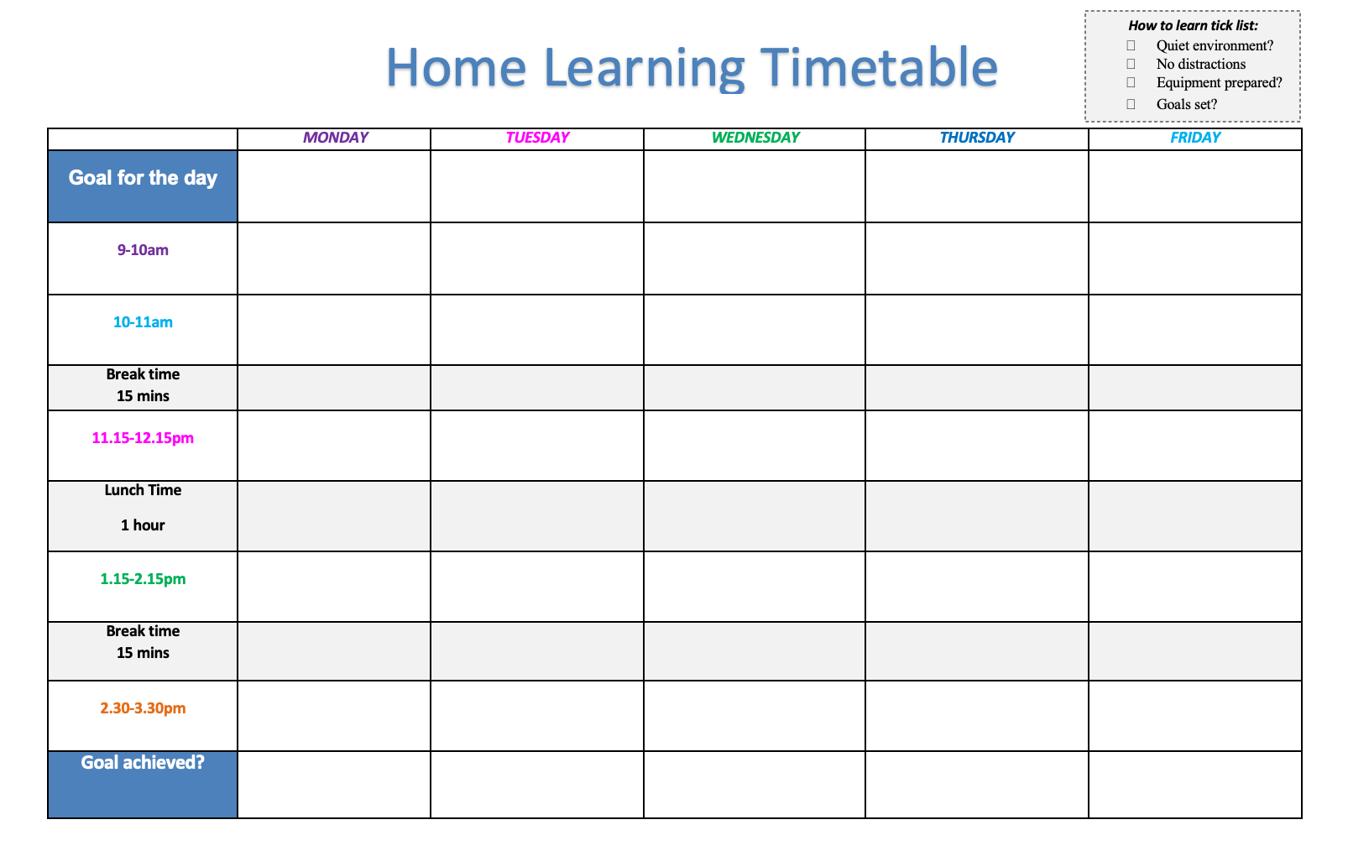
Tips for Creating a Learning Environment
Environment
Create a quiet, comfortable, distraction free area
Be prepared to learn
Equipment, resources and refreshments
Set targets
Give yourself goals to achieve so you know if you’re on track
Take breaks
Set regular break times when you take time to refresh
Learning Timetable
Create and use a timetable to set goals.

